Slide 1

Claude Lauper, Deputy Head FI Emerging Markets
  Zürcher Kantonalbank and the Cooperation with the other Cantonal Banks
  Pesentation at the Banking Conference on 24th April 2014
  „Banking in Russia‘s Regions: Opportunities for Cooperation between Swiss Banks and Russian Regional Banks“
  Organized by the Joint Chamber of Commerce Switzerland-CIS
  in Partnership with the Association of Regional Banks of Russia

Slide 2
Cantonal Banks
History
    Founded during second half of the 19th century
    Large commercial banks focused on railway, trade and industry financing
    Financing shortage for craftsmen and farmers eased through cheap mortgages of Cantonal Banks
    Association of Swiss Cantonal Banks was founded at the beginning of the 20th century
Ownership
    Still all majority owned by the local cantons
    Twelve of the cantonal banks are publicly traded

Slide 3
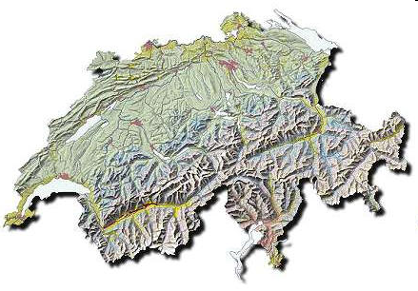

Cantonal banks
Number of Cantonal banks: 24
Branches: 805
Employees: 18’700
Total Assets in bn CHF: 514
Overall Market share: 30 %
Notes:
Quelle: VSKB.ch

Slide 4
Cantonal Banks
Smaller cantonal banks concentrate on savings and mortgage business,
larger ones are universal banks, however with a traditional focus on mortgages and on retail customers and small- and medium-sized enterprises
    Canton-wide dense branch network
    Overall 24 cantonal banks which control around one third of the Swiss domestic banking market in terms of assets
    Strong emphasize on regional social and economic responsability, high ethical standards, promoting sustainable management
    21 of 24 cantonal banks enjoy an unlimited cantonal guarantee
    Cantonal ownership leads to limited shareholder value focus and long lead time for major organisational changes

Slide 5
Cantonal Banks
Network Partners
The Cantonal Bank Group includes around 20 Network Partners as competence and production centres. Network Partners are joint ventures operating at the supra-regional, national or international level which are owned either by all or some of the Cantonal Banks.
The major Network Partners are:
    Swisscanto (Investment funds / retirement products / pension fund advisory & management etc.)
    Mortgage Bond Centre of the Swiss Cantonal Banks <Pfandbriefzentrale> (AAA rated mortgage bond institution with outstanding bonds of CHF 34 bill.).
    Management training cooperation
    Aduno Group – joint venture with other Swiss retail banks (provider of cashless payment products e.g. 1 mio. Credit cards / 50’000 contracting partners etc.)

Slide 6
Cantonal Banks
Services provided by Zürcher Kantonalbank to some of the other Cantonal Banks
Zürcher Kantonalbank offers various services to the other Cantonal Banks e.g.:
    CLS Third Party Services (8 Cantonal Banks)
    Trade Finance Services (19 Cantonal Banks are outsourcing their documentary business to ZKB)
    Documentation Advice (14 Cantonal Banks)
    Joint negotiations of terms and conditions of third party service providers (i.e. account maintenance / payment services etc.)
    Central Clearing Broker for Derivatives
    The various Cantonal Banks are competitors in many areas despite the co-operations in some products and services.

Slide 7
Cantonal Banks
Challenges for Cantonal Banks
    High dependence on mortgage and corporate lending businesses and thereby on interest margins development
    Regionally concentrated with high exposure to small- and medium-sized companies
    Critical mass, high IT-costs, high costs of branch network
    Increasing volatility of earnings

Slide 8
Zürcher Kantonalbank at a glance
Establishment 1870 as an independent, public-law institution
Key Figures | 2013 | 2012 | 2011
Total assets in CHF billion | 149.7 | 150.7 | 134
Net equity in CHF billion | 9.2 | 8.8 | 8.6
Net income in CHF million | 797 | 744 | 769
Cost/income ratio in % | 62.7 | 64.4 | 63.5
Return on equity in % | 9.2 | 9.0 | 9.6
Tier 1-Ratio in % | 16.2 | 15.2 | 13.4
Employees | 4’818 | 5’068 | 5’101
Rating S&P | AAA/A-1+ | AAA/A-1+ | AAA/A-1+
Rating Moody's | Aaa / P-1 | Aaa / P-1 | Aaa / P-1
Rating Fitch | AAA/F1+ | AAA/F1+ | AAA/F1+
Type of bank High performing Swiss full-service bank
Size Leading Swiss State Bank
Affiliation Zürcher Kantonalbank is wholly owned by the canton of Zurich.
Network ZKB maintains the largest network of branches in the canton of Zurich.
Executive board 9 members (1 member being elected as CEO)
Income structure | 2013 | 2012 | 2011
Net interest income | 53% | 54% | 56%
Income from trading operations | 16% | 18% | 17%
Net commission and fee income | 26% | 25% | 25%
Other ordinary income | 5% | 3% | 2%
State guarantee Under the law, the state bears responsibility for all Zürcher Kantonalbank's liabilities should the bank's resources prove inadequate. This state guarantee acts as a stabilising force for the financial market as a whole, particularly in times of economic uncertainty.

Slide 9
Strategy
We are…
    … the leading universal bank in the Economic Area of Zurich with a strong and global network of banking partners
    … a leading provider of financial services for banks, corporates, institutional clients and public law entities
    … an internationally well recognised interbank counterparty and the centre of competence for the Group of Swiss Cantonal Banks in Trade and Export Finance

Slide 10
Vision: Zürcher Kantonalbank - the International Banking with the local touch
Preferred partner for
    Trading
    Trade finance
    Interbank business
    Private banking
First-class provider of
    Finance for discerning customer segments
    Sophisticated investment and asset management solutions
    Trading and capital markets
  Leading financial services provider
International
National Leadership
No. 1 in Greater Zurich Area

Slide 11
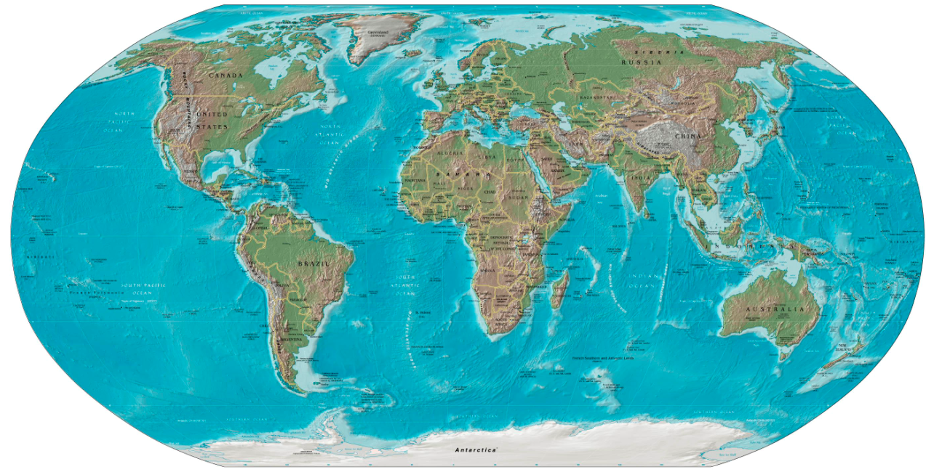
International presence
The representative Office in Beijing, Mumbai, São Paulo and Singapore...
Zürcher Kantonalbank
Finance (Guernsey) Ltd
Zürcher Kantonalbank
Beijing Representative Office
... develop and take care of our relationships with correspondent and central banks in the respective region
… acquire and develop trade and export finance business
…support ZKB’s trading products for correspondent and central banks
... introduce our Swiss clients in the foreign markets and support them by establishing a foreign network
... provide ZKB with 'local' information on the most important export markets for our clients
Zürcher Kantonalbank
Representações Ltda.,
São Paulo
Zürcher Kantonalbank
Österreich AG
Zürcher Kantonalbank
Mumbai Representative
Office
Zürcher Kantonalbank
Singapore Representative
Office

Slide 12
General Product Offering
Trade Finance: Short Term and Medium-/ Long Term
    Letters of Credit
    Advance Payment-/ Performance-/ Bid-Bonds
    Commodity Trade Finance
    Export Finance
    Trade Finance Syndication (risk mitigation)
    Documentary Collections
    Import and Pre Export Facilities
Trading & Capital Market
    Foreign Exchange (FX)
    Money Market Deposits (Loans)
    Bonds
    CH Equities
    Banknotes and Precious Metals
    Derivatives
Transaction Services
    Payment & Cash Services
    Securities Services (Brokerage & Custody)
    Online Services

