Slide 1
Russian Banking Sector
JCC Switzerland-Russia/CIS
Zurich, April 2014

Slide 2
Agenda
Banking system trends
Basel III and DSIBs regulation
Discussion

Slide 3
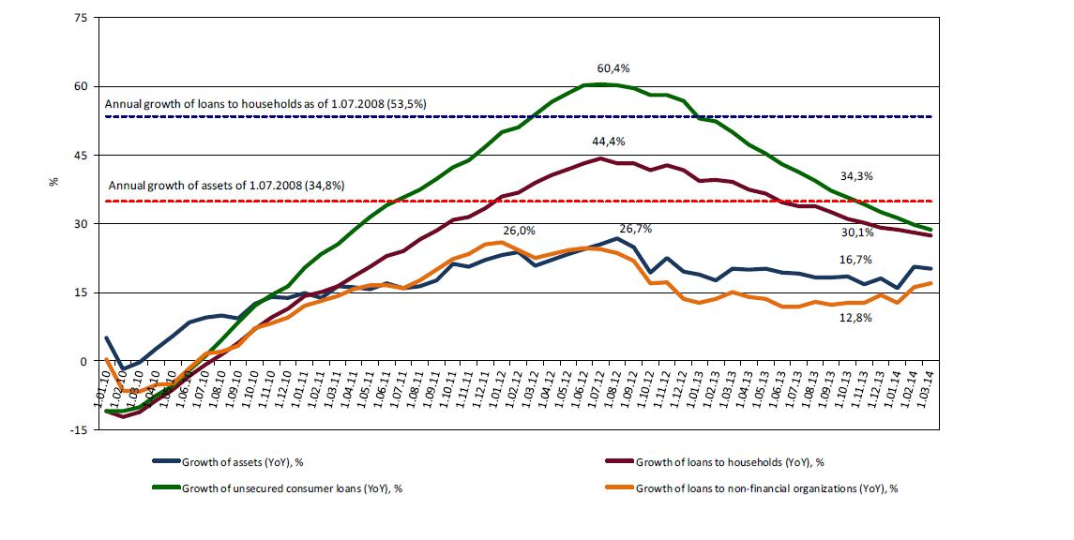
Unsecured retail lending slow down
Bank of Russia’ regulatory response was targeted and efficient

Slide 4
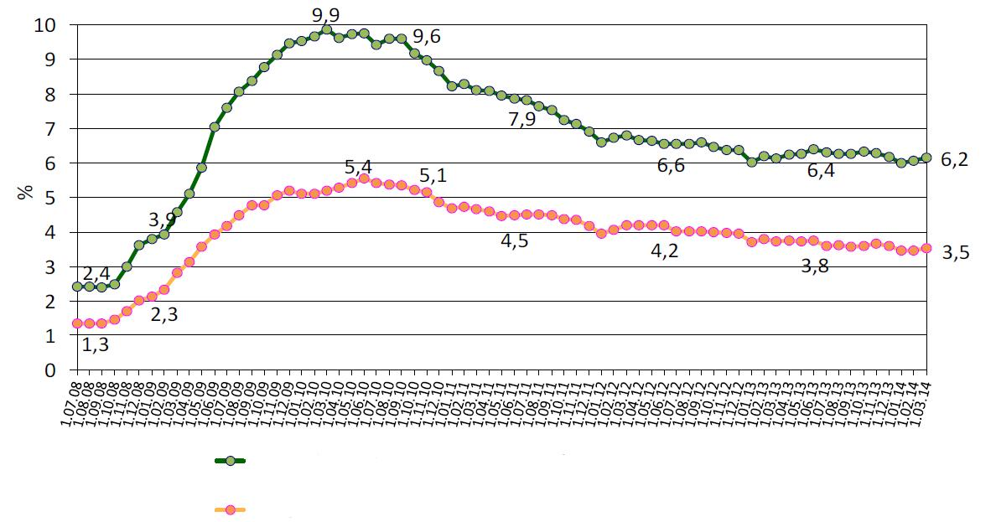
Loan quality adequately reflects economic situation
share of loans of 4 and 5 categories in total portfolio
share of past dues in loans, deposits and other placements

Slide 5
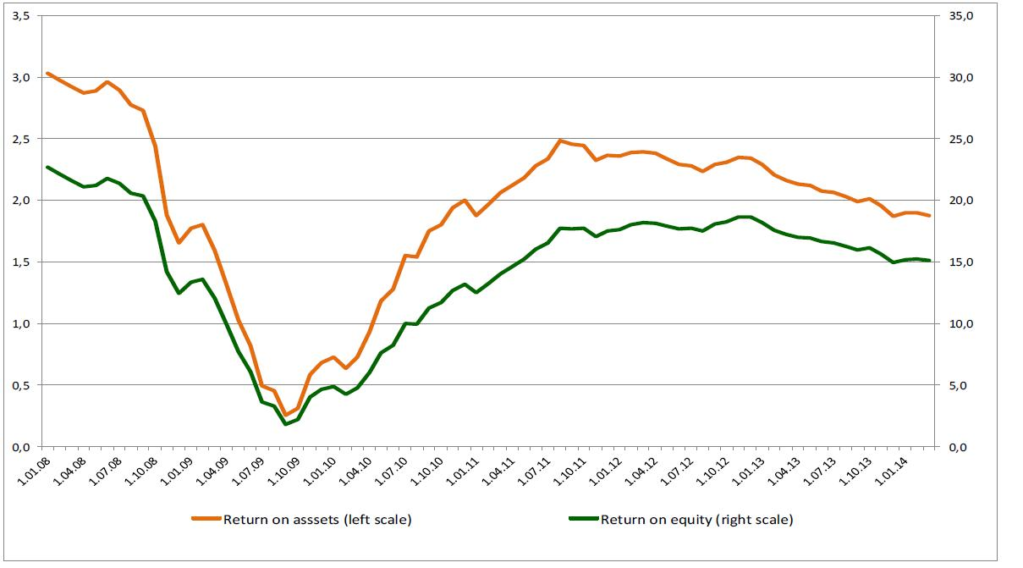
Operating environment becomes challenging
Profit as for 1Q 2014 – 233 bln. rub. (1Q 2013 – 239 bln. rub. )

Slide 6
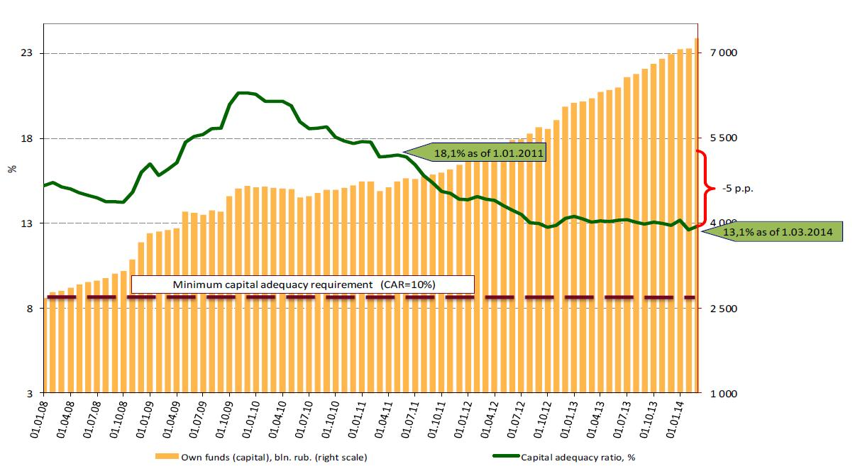
Banks learn operate with Basel III capital requirements
CET1 min = 5,0%

Slide 7
Basel III in Russia
Capital Adequacy Requirements
13%
Countercyclical
buffer
Total capital
0-2,5%
10,5%
Current situation
Tier 2 2%
10%
Tier 2
Total capital ≥ 10 percent of RWA
Tier 1 ≥ 5,5%
CET1 capital ratio ≥ 5,0%
Point of non-viability trigger for CET1=5,5%
8,5%
Additional Tier 1 1,5%
7%
Capital conservation buffer 2,5%
5,5%
Additional Tier 1 0,5%
Perspective
Tier 1 ≥ 6,0% in 2015
CET1 5%
CET1 4,5%
Basel III
minimum requirements with buffers (fully load, start 1.01.2019)
Bank of Russia
current minimum capital requirements (start 1.01.2014)

Slide 8
Basel III in Russia
Liquidity Coverage Ratio
Current situation
Liquidity requirements in Russia in force since 1990s (Ratios N2, N3, and N4 under Regulation 139-I)
Implementation of LCR
Reporting on LCR in 2014 for monitoring purposes
Quantitative impact study
Calibration of some run-off factors
Development of alternative liquidity approaches due to an insufficient supply of HQLA
LCR will be introduced as a prudential ratio starting from January 1, 2015

Slide 9
DSIBs Regulation and Supervision
- Bank of Russia published methodology for DSIBs designation (Bank of Russia Regulation on 16.01.2014 №3174-U)
- Quantitative indicators and supervisory judgment used (in details see App.)
- Currently 50-60 banks in Russia could be considered as DSIBs
- Representing 4/5 of banking sector total assets: state-owned, Russian private and foreign subsidiaries
- No designation performed yet

Slide 10
DSIBs Regulation and Supervision
Prudential regime: proposed framework
№ | Regulatory measures | Implementation date
1. Capital requirements
1.1 | DSIBs High Loss Absorbency (HLA) - additional requirements (buffer) to common equity (1% of risk-weighted assets). | Start 1 Jan 2016
1.2 | Leverage Ratio∗. | Disclosure - 2015. Regulatory standard - 2018.
1.3 | IRB Approach (voluntary). | Beginning 2015; in case of bank’s voluntary decision to be examined on compliance with minimum IRB requirements
2. Liquidity requirements∗
2.1 | Liquidity coverage ratio. | Monitoring – 2014. Regulatory standard – 1Q 2015.
2.2 | Net stable funding ratio. | Regulatory standard – 1Q 2018.
Other DSIBs requirements
Recovery and resolution plans (obligatory - 2015);
Internal Capital Adequacy Assessment Process (ICAAP) and Supervisory Review and Evaluation Process (SREP)
^{* -} final prudential rules will be defined after consultations with banking industry

Slide 11
DSIBs Regulation and Supervision
Prudential regime: proposed framework
DSIBs capital adequacy requirements
№ | Common Equity Requirements (% of RWA) | 2016 | 2017 | 2018 | 2019
1. | Minimum Common Equity Capital Ratio | 5% | 5% | 5% | 5%
2. | Minimum Capital Conservation Buffer | 0,625% | 1,25% | 1,875% | 2,5%
3. | DSIBs HLA Surcharge | 1% | 1% | 1% | 1%
4. | Total Common Equity Capital Ratio | 6,625% | 7,25% | 7,875% | 8,5%
No decision on countercyclical buffer in the proposed package

Slide 12
Cooperation with foreign supervisory authorities
National Banks and Supervisory Authorities of selected European countries
Austria
The Bank of Russia
Estonia
Belgium
Portugal
Cyprus
Latvia
Slovenia
Malta
Finland
Luxembourg
France
Germany
Italy
Netherlands
Spain
Greece
Ireland
Slovakia
- MoUs signed

Slide 13
Russian Banking Sector
Appendix

Slide 14
Appendix 1
SIBs designation
1. Scoring approach (quantitative indicators)
Indicators
Description
Weight
Size of credit organization
Total assets including
off-balance sheet items
50%
Intra-financial system assets
12,5%
Interconnectedness
Intra-financial system liabilities
12,5%
Retail deposits
Total retail deposits
25%
Basis of calculation: year-end data for last 3 years.
Cut-off: banks with highest score, representing 4/5 of banking sector assets.

Slide 15
Appendix 1
SIBs designation
2. Supervisory judgment
Category of credit organizations
Description
Credit organization with considerable amount of retail deposits
Total volume of retail deposit is more than 10 billion rubles
Information on bank significance for the banking group (holding) as well as for the financial sector of Russian Federation.
Credit organization – member of banking group (holding)
Credit organization carrying the functions of: central counterparty, central securities depository, trade repository, securities settlement system or payment system.
Credit organization acting as financial market infrastructure.
At this stage the DSIB status in Russia will not result in any additional prudential requirements .
DSIBs prudential regime is under discussion

Slide 16
Appendix 2 Financial megaregulator: The Bank of Russia (prospective structure)
The Bank of Russia Financial Markets Service
Securities and Commodities Market Department
Collective Investments and Trust Management Department
Regulation and Supervision
Insurance Market Department
General Directorate of Microfinance Market
Admission to Financial Markets Department
Market
Development
Financial Markets Development Department
Customer and Investor Protection
General Directorate of Combating Unfair Market Practices
Consumers and Minority Shareholders Protection Service
Department of Collecting and Processing Reporting from Non-Credit Financial Institutions
Reporting

Slide 17
Appendix 2 Financial megaregulator: Regulated and supervised institutions
Non-banking financial institutions which carry out the following kinds of activities
professional participants of the securities market (incl. brokers (885), dealers (889), depositories (616), asset management companies (784), registrars (37));
investment fund, mutual fund and private pension fund management companies (402);
specialized depositaries of investment funds, mutual funds and pension funds (43);
equity investment funds (7);
clearing activities (6);
central counterparty activities (3);
trade organizing activities (8);
central depository activities (1);
insurance activities (598);
private pension funds (119);
microfinance institutions (4667);
credit consumer cooperatives (3906);
housing savings cooperatives (90);
credit bureaus (25);
actuarial activities;
credit rating agencies (9);
pawnshops;
agricultural credit consumer cooperatives.

Slide 18
Appendix 2 Financial megaregulator: Prospective directions of development
Start
2014
2015
2015
2015
Code of Corporate Governance
Solvency II
IFRS
Pension Guarantee System

