Slide 1
Banknote Circulation for the 21st Century: It‘s not the Same
Barnabas FERENCZI
Moscow 22 November, 2013
Notes:
Systemfolie

Slide 2
WHAT HAS CHANGED
IN BANKNOTES CIRCULATION?

Slide 3
More volume to your Cash Centers

Slide 4
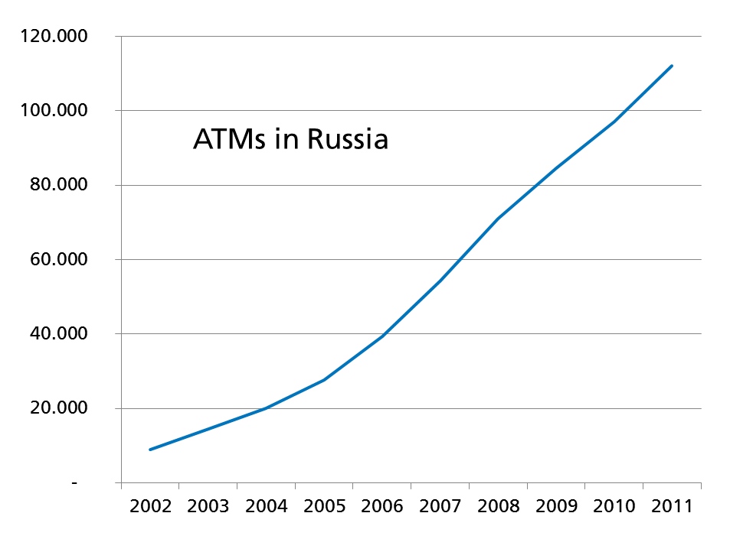
Machines dispense and accept banknotes
In Russia alone…
ATM: ca. 120.000
Banknote Deposit Machines:
ca. 23.000
Teller Assist. Units:
ca. 10.000

Slide 5
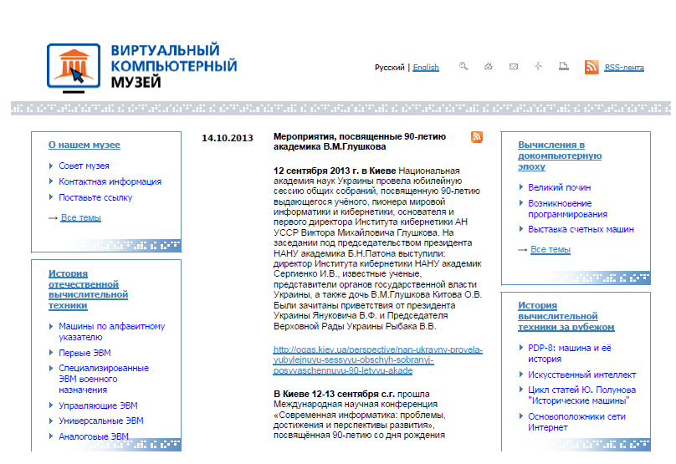
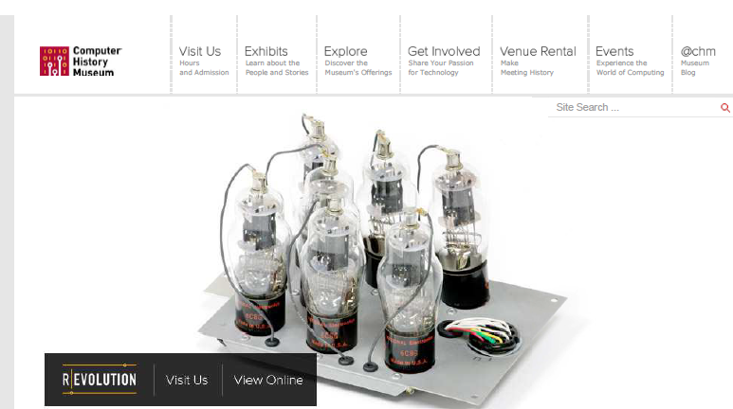
Digital Transformation

Slide 6
WHAT ARE OUR ANSWERS?

Slide 7
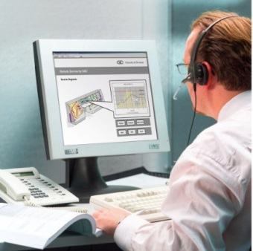
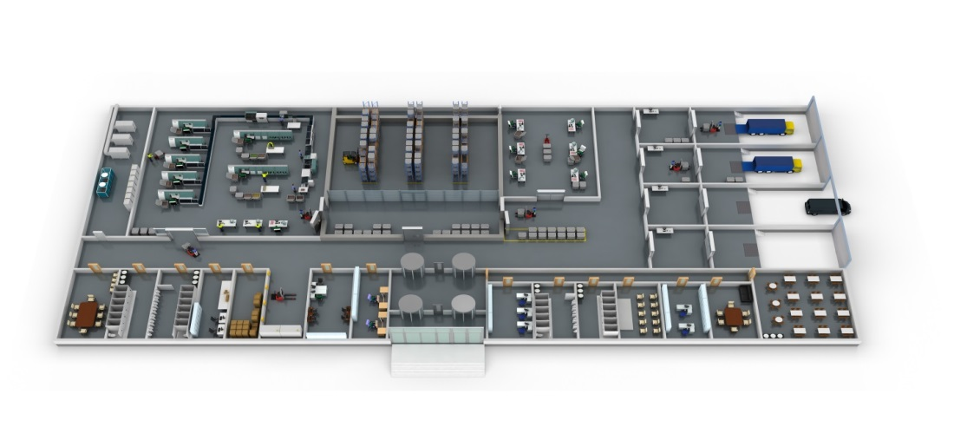
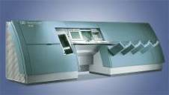
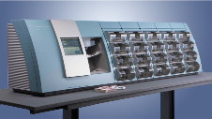

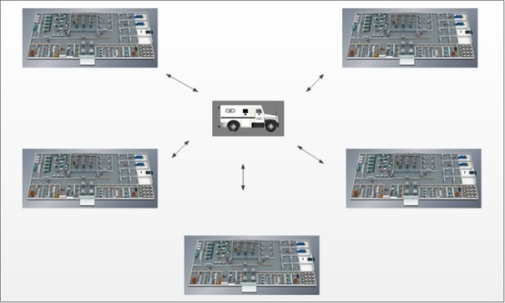
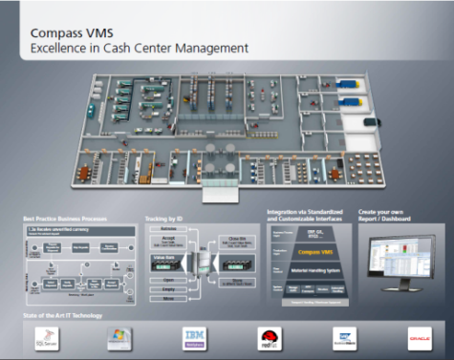
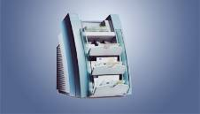
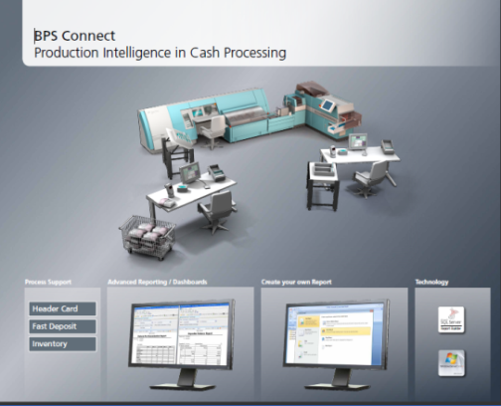
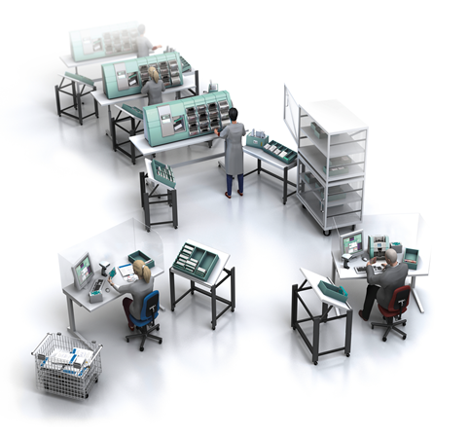
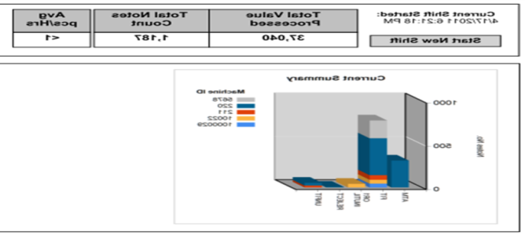
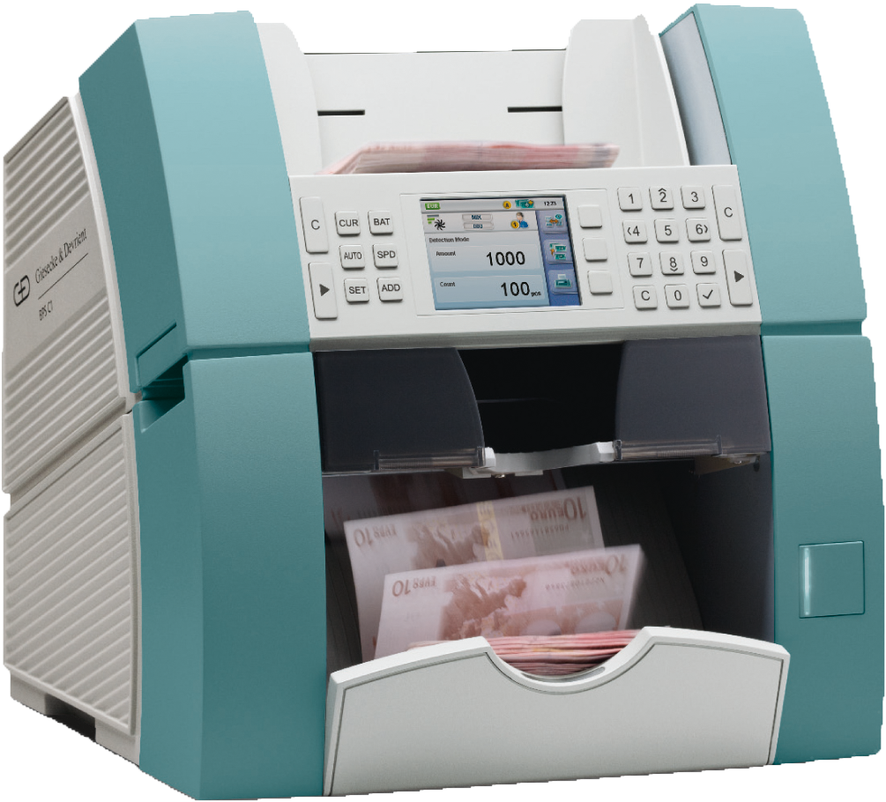
From Products … to Processes
NEW!
Remote Access
based Services
Cash Centre Planning & Optimization
NEW!
BPS® M5
BPS® C4
Managed Service
NEW!
reNEWed!
Inventory Control and Optimization
Software
solutions
Numeron®
NEW!
Cash
Room
Design
BPS® C1

Slide 8
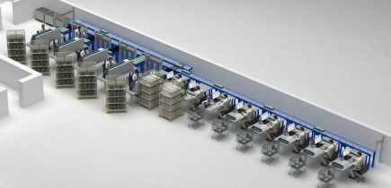
Cash Room: ‘’Sushi Belt’’ solution with BPS C4s
BPS® C4
Banknote processing with BPS C4
Intelligent
Conveyor Belt
Preparation Desks
Solution implemented
at a CIT in Germany:
Labour costs savings: 30%
Pay-back period: 3 years
Security improved
Folienmaster

Slide 9
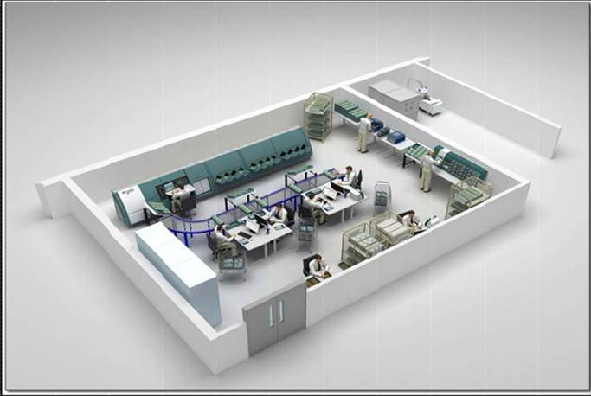
Case Study: Headercards solution with BPS M5
BPS® M5
Reject handling & reconciliation
Banknote processing with BPS M5
Preparation
Folienmaster

Slide 10
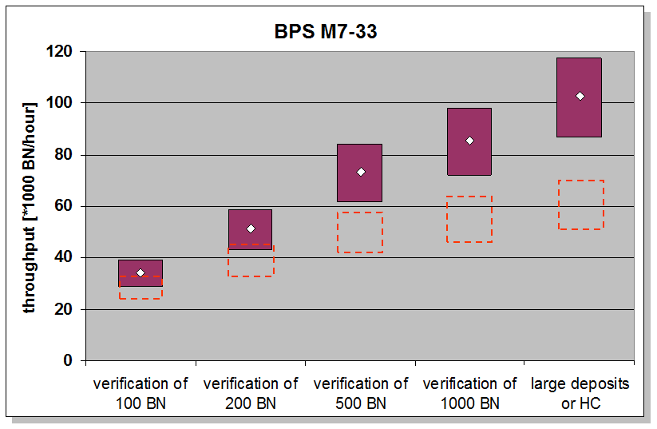
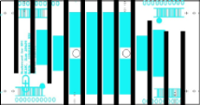
Technology investment and process optimisation
Productivity of BPS M5 33 Banknote/Min speed
– compared with BPS1000 20 Banknote/Min
Based on a productivity analysis at Central Banks
Small deposits verification … → … Larger Deposits / Headercards

Slide 11
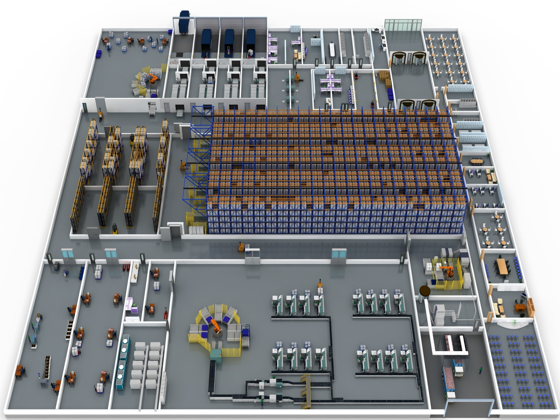
Case Study: full cash centre design
Commissioning
Receiving/
Shipping
Material
Handling
Vault
Pre-/Post-
processing
Processing

Slide 12
YOU NEED A PARTNER,
WHO UNDERSTANDS THAT ALL

Slide 13
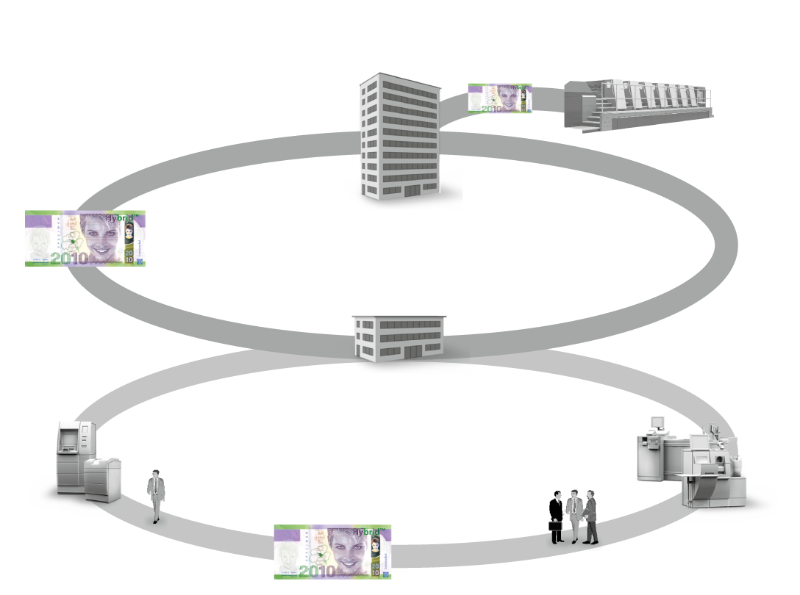





We know almost everything about the cash cycle ...
No one else has
such extensive experience.
> 35 customers
> 150 customers
Overall install base
> 22 000 systems
> 3000 customers

Slide 14
