Slide 1
Michael J Lambert Deputy Associate Director Board of Governors of the Federal Reserve System
“Trends in U.S. Currency in Circulation” 5th International Conference Moscow, Russia April 19-20, 2012
Notes:
Good morning. It’s a pleasure for me to be here again. I last spoke at this conference in November 2009, when I provided a summary of currency activity in the immediate wake of the global financial crises.

Slide 2
Outline
General Trends in Currency in Circulation
Economic Crises and Changes in Demand
Post Crises and Trends in Currency in Circulation
Current Situation
Conclusions
Notes:
Today, I will discuss how the financial crises affected demand for U.S. banknotes and currency in circulation. I will also provide a brief history of how the value of currency in circulation has changed over the past several decades, how the financial crisis affected demand for currency, and how the demand for currency has changed since the financial crisis. Finally, I will describe the current demand situation for U.S currency and the drivers for continued high growth in U.S. dollar banknotes.

Slide 3
Currency in Circulation: Value and Percent Change 1960 - 2011
Notes:
This slide may be familiar to some of you. We continue to update the numbers to accurately portray the growth of currency in circulation in terms of value and the annual rate of growth from 1960 to the present. Since my last presentation at this conference, the value of U.S. currency in circulation has increased an astonishing amount of more than sixteen percent, or $146 billion over the past two years, from $888 billion in December 2009 to $1.034 trillion in December 2011. You will also notice the growth rate having returned to the levels experienced during the 1970s through the 1990s.

Slide 4
Value of Currency in Circulation: Growth Rate Comparison (by decade)
Notes:
As a review, the value of currency in circulation has experienced strong growth over a forty year period ending in 2000. I’ll provide more detail on the period of the 2000s. The 1970s are notable with growth rates exceeding 9 percent, but inflation during that period was high and accounts for much of the nominal growth. The 1980s and 1990s also experienced strong growth at just below 8 percent, but inflation was not the driver. The foreign component of the amount of currency in circulation is estimated to have increased significantly beginning in the late 1980s and continued to grow through most of the 1990s. Based on estimates of net payments, international demand for U.S. currency increased 219 percent from 1989 to 1990 during the first Gulf War. As another example, from 1993 to 1994 international net payments increased 24 percent during the Mexican peso crisis.
As you can see, however, the average annual rate of growth for the 2000s declined to about 5.3 percent.

Slide 5
Value of Currency in Circulation: Annual Growth Rate
0.8% Growth through August 2008
Notes:
Looking at the year-over-year growth rates in the 2000s, the dramatic declines are shown in the period 2005 to 2006, where the average annual growth rate declined from 5.4 percent to only 3.2 percent, followed in the period 2006 to 2007 with substantial declines from 3.2 percent to only 1.1 percent. Consistent with these declines, the period from 2007 to 2008 experienced further declines through August 2008 to less than one percent.
It is important to note, that although growth slowed, Reserve Bank volumes continued to increase; receipts however were growing faster than payments causing the lower overall growth rates for currency in circulation.
The financial crisis changed the story completely. With the major effects of the financial crisis occurring during the fourth quarter 2008, the annual growth rate for 2008 relative to 2007 increased from less than one percent through September to 7.7 percent for the year. And, although the growth rate in 2009 relative to 2008 declined to 4.1 percent, it has again continued to increase strongly for 2010 and 2011, with an almost 10 percent increase from 2010 to 2011. Following the crisis, however, payment and receipt patterns changed (particularly for the $100 note). No longer were receipts growing faster than payments…payments far outpaced receipts and while payments continued to surge, receipts remained flat.

Slide 6
Value of Currency in Circulation: 2006 - 2012
Notes:
Here is another way to view the growth in currency in circulation. The gap between the lines represents the amount of growth.
Interestingly, growth of U.S. currency in circulation began to moderate in 2006 and continued into 2007 (you can see the distance between the lines is small). That slow growth continued into 2008, as I referenced in the previous slide, with less than 1 percent growth experienced up to September 2008. As you can see from the purple line representing 2008, the slope of the line changed markedly beginning in October and continuing through December, with overall growth for the year at 7.7 percent. A quick review of the lines representing 2009, 2010, 2011, and 2012 shows continued strong growth that begins in January and continues the end of each year. all started with a higher base of currency in circulation than the previous year and continued to grow throughout the year.
So far in 2012, the value of currency in circulation has already increased by $33 billion, and you will note that the gap between the pink line representing the current year and the dashed blue line representing last year is larger than the gap between 2008 and 2009 (the solid purple and dark green dashed lines), illustrating that the growth we are experiencing now exceeds that seen during the crisis.

Slide 7
Currency in Circulation: Transactional vs. Store of Value Denominations (in value)
Notes:
From a value perspective, the major driver for the increases to currency in circulation since the financial crisis is increased demand for the 100 dollar note. This chart shows the dramatic increase in the high denominations, compared with moderate increases in the $1 through $20 denominations. The value effect of the $100 note overshadows increases in other denominations.
Discuss with them that we typically think broadly about the $50 and $100 notes as store of value, although we recognize that there is also a transactional component to those denominations, and that the $1 through $20 notes are typically used exclusively in day-to-day transactions.

Slide 8
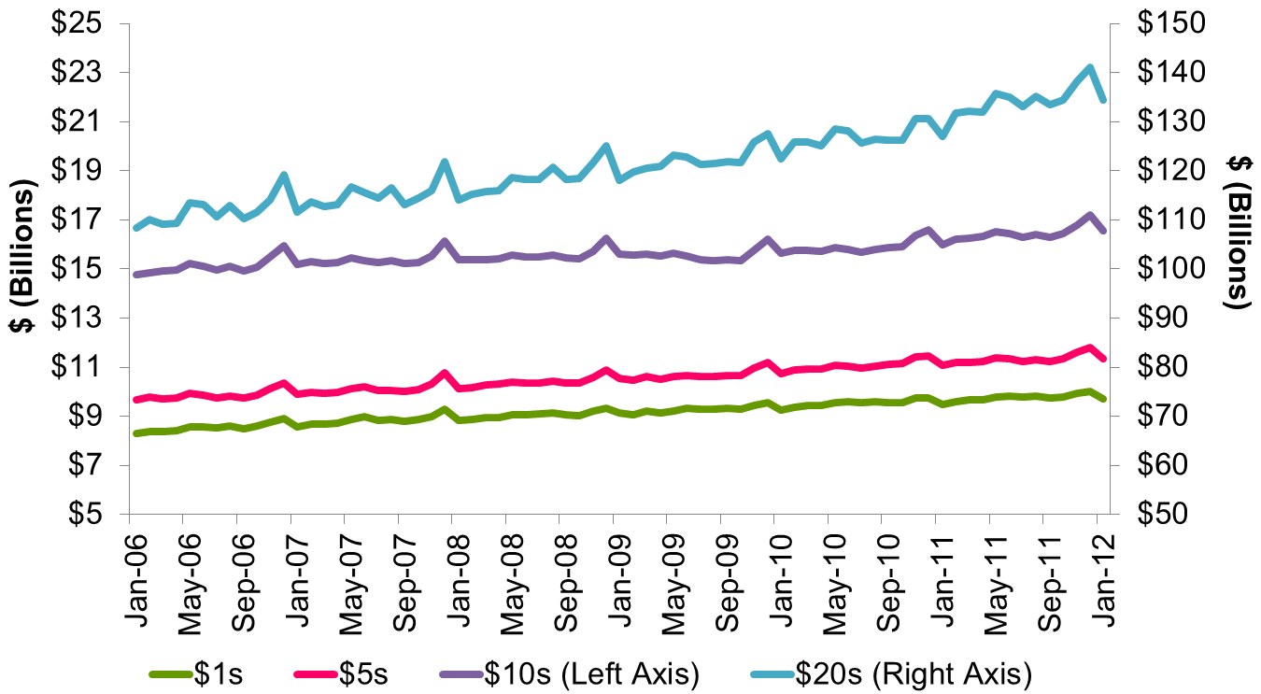
Value of Currency in Circulation: Transactional Denominations
Notes:
A look at the transactional denominations reflects that they were relatively unaffected during the financial crisis, but the value of $20 notes in circulation has increased significantly over the past year. The $20 note is the primary ATM-denomination in the U.S. and this growth may indicate that more domestic consumers are using cash.
In fact, a 2010 study of consumer payment choices from the Boston Federal Reserve found that during the recent recession, cash payments and cash holdings increased over 25 percent each, even though total consumer payments declined by about four percent. Weaker economic conditions likely encouraged a shift to cash because it helps some consumers cut costs and improve budgeting.

Slide 9
Currency in Circulation: Transactional vs. Store of Value Denominations (Billions of Pieces)
Notes:
Before focusing on the main international story of $100 note demand, I again want to recap and stress that growth for U.S. currency is not only occurring internationally for the $100 note, but domestically for transactional denominations as well. In fact, from a pieces perspective, half of the growth is attributable to the highest denominations, while the other half is because of growth in the $1 through $20 denominations. Both the transactional and store of value denominations have increased roughly 2 billion pieces since the crisis.

Slide 10
Value of Currency in Circulation: Store of Value Denominations
Notes:
As this chart shows, the value of both the $50 and $100 banknotes in circulation have been increasing over the past five years. However, the value of both the $50 and $100 notes in circulation were fairly flat during 2007 and early-2008. When the financial market turmoil intensified in late-2008, the value of $100 notes increased sharply, from $584 billion at the end of September 2008 to $625 billion by year end. The value of $100 notes in circulation has continued to experience strong growth since the financial crisis. As of January 31, 2012, the value of $100 notes in circulation was $785.8 billion.
This drastic increase begs the question: where are all the $100 notes going???

Slide 11
Monthly $100 Note Activity: International vs. Domestic
Notes:
First, we need to determine if it is domestic or international demand driving the increase. This chart shows the value of payments and receipts to domestic and international customers from January 2006 thru January 2012. Although domestic demand has been relatively flat over this time period, with a small increase during the financial crisis, the gap between domestic payments and receipts has decreased over this time period. International demand, however, increased significantly during the financial crisis of 2008, leveled off during early-2010 and has been strong ever since mid-2010 and the gap between international payments and receipts has increased over the past year, indicating that international consumers are holding on to U.S. banknotes as a store of value and not returning them.
Many international factors affect the demand for US currency, largely political and economic instability, but also policy changes. An example of this can be seen in explaining the increasing domestic receipts (the upward sloping dashed blue line). The narrowing of the gap between domestic payments and receipts is likely not a shift in domestic usage patterns, but a result of policy changes in Mexico. As part of new anti-money laundering rules, Mexico announced plans in early June 2010 to limit cash dollar deposits and payments by businesses operating in tourist and certain northern border areas to $7,000 per month. In other areas of Mexico, the aggregate limit will be $4,000 per month. Banks will still be allowed to sell dollars to the public under the new rules. Mexican President Ernesto Cordero reportedly said that Mexican banks receive as much as $10 billion a year in suspicious dollar flows in cash that can’t be explained by legitimate economic activity.
Following the regulations, Mexican deposits to Reserve Banks decreased from about $650 million per month to $350 million per month (annual decrease of about $3.6 billion). Some of this is likely returning to the Reserve Banks through domestic banks, contributing to the higher domestic receipts observed in 2011. This example is telling, while we try to break-out international and domestic activity, they are linked and not easily separable. We devote a lot of time to understanding conditions and policies in many countries where the U.S. dollar circulates so that we can anticipate how local factors will affect demand.

Slide 12
Annual $100 Note Activity: International
Notes:
While local policies can affect demand, so can global instability. This chart shows how the overall demand pattern has changed since the financial crisis. Until the financial crisis of 2008, international customers deposited more $100 notes to Federal Reserve Banks during the year, than they ordered (receipts were greater than payments). Beginning in 2008, however, the pattern changed and international customers now order more $100 notes than they return to Federal Reserve Banks during the year. In other words, the notes go out, but they don’t come back. This pattern has existed every year following the financial crisis and was most significant last year because of political unrest in many parts of the world during 2011.

Slide 13
International $100 Note Activity: 2007 Net Exporters and Importers
Notes:
To get a sense of where the notes are going and how demand patterns have changed, I’m going to show you two maps. The first represents the pre-financial crisis world (in 2007). Note the division of blue and red: blue represents countries that are net exporters of U.S. dollars (meaning they return more currency to the U.S. than they receive from the U.S.) and the red represents countries that are net importers (meaning they receive more currency from the U.S. than they return to the U.S.). As you can see, parts of Europe, most of Russia, the Commonwealth of Independent States, and Asia were net exporters of U.S. banknotes.
I’m now going to advance the slide to the post-crisis world…2011. Note what happens to the blue countries.

Slide 14
International $100 Note Activity: 2011 Net Exporters and Importers
Notes:
There is a lot more red. Aside from China, India, Turkey, Mexico, and Chile, along with some others, the rest of the world now receives more currency than they return to the U.S. In 2011, the majority of Europe, Russia, the CIS, and the Middle East and North Africa region were no longer exporters of U.S. dollars, they were now net importers of U.S. banknotes. Although the majority of Europe appears to be net importers of U.S. banknotes, this is because most of the Federal Reserve extended custodial inventory sites are located in Europe. The notes are shipped to these ECI hubs and then redistributed to other countries.

Slide 15
Distribution of International Payments – 2007 and 2011
2007
2011
Notes:
In addition to looking at overall net importers and exporters, it is also useful to look at how the share of payments and receipts has changed from 2007 to 2011. This chart shows that in 2007, the majority (56 percent) of international payments were made to Europe and Russia/CIS. While they still maintained the majority share of payments in 2011 (50 percent), the share of total payments to the Americas and Middle East North Africa regions increased from 22 to 34 percent between 2007 and 2011.
The increased share of payments to the Americas and the MENA regions are other examples of how local conditions affect demand. The increased share to the Americas is largely attributable to increased payments to Argentina in 2011. Argentina experienced considerable political uncertainty surrounding the presidential election in October 2011. Following the election, the new president implemented more restrictive policies governing foreign exchange transactions causing additional uncertainty. During this time period, monthly payments to Argentina doubled from about $1.1 billion during the first half of the year to $2.5 during the second half of the year. In fact, payments to Argentina during November 2011 were the second highest level ever reported at nearly $4 billion. Demand from Argentina subsided following the election indicating that either there is less demand for the U.S. dollar, or that the new policies have left some demand unfulfilled.
The increase in the share of payments going to the Middle East and North Africa region is largely attributable to the political uncertainty in many Arab countries (including Egypt, Libya, and Qatar) in early-2011 as well as a 300 percent increase in payments to the United Arab Emirates. Payments to the UAE during 2011 totaled $7.3 billion.
It is also important to point out, that while the share of payments tell the story about how one country’s demand changes relative to other countries, remember that it is the context of increasing overall payments…a decreasing share does not mean the demand in that country decreased. In fact, the 2011 pie is 62 percent larger than the 2007 pie, meaning that total international payments in 2007 were $98.2 billion, compared with $158.8 billion in 2011.

Slide 16
Distribution of International Receipts – 2007 and 2011
2007
2011
Notes:
The story is very different for receipts. Whereas the payment pie got larger, the receipt pie shrunk by 16 percent from 2007 to 2011, from $119.3 billion to $100 billion. In this case, a declining share does mean a decline in receipts.
The largest changes are a decline in share in receipts from Russia/CIS from 17 percent in 2007 to 5 percent in 2011, and a corresponding increase in the share in receipts from Europe and Asia from 40 percent in 2007 to 56 percent in 2011.

Slide 17
Conclusions
Currency in circulation continues to grow.
Annual incremental value increases remain strong.
Economic and political uncertainties continue to drive demand.
Global financial instability is latest example of return to $100 note as store of value during uncertain times.
International order and deposit patterns have changed following the financial crisis.
New markets have contributed to overall growth increases.

