Slide 1

International Banking Council
Meeting
October 04-06, 2021
Odessa, Ukraine

Slide 2

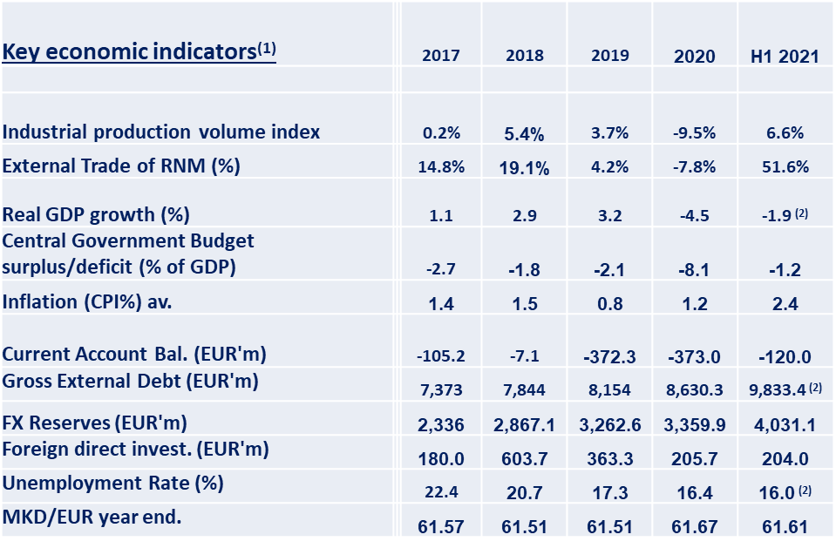
The Republic of North Macedonia - Macroeconomic Environment:
In May 2021, The Fitch agency has
confirmed the credit rating of North Macedonia
BB +, with negative outlook as a result of the
global pandemic. The Macedonian economy
is characterized by low inflation and financial
stability as a result of the conduct of a credible
financial and macroeconomic policy, consistent
with the strategy of a stable exchange rate
of the denar against the euro.
In February 2021 the agency Standard & Poor's
confirmed the credit rating of North Macedonia
as "BB-stable", emphasizing the efforts of the
Macedonian government towards adequate
budget planning and its dealing with the negative
consequences of the Covid-19 pandemic,
as well as future planned capital expenditures
Source: Ministry of Finance, State Statistical office, NBRNM.
As at 31.03.2021

Slide 3
Macedonian Banking Sector (I) - Structure and characteristics as of 30.06.2021
Structure
13 active banks** (5 large*, 5 medium and 3 small)
2 saving houses
Characteristics
High concentration with the large banks
* As at 30.06.2021, the group of large banks is consisted of the following banks: Komercijalna Banka AD Skopje, Stopanska Banka AD Skopje, NLB Banka AD Skopje, Sparkasse Banka Makedonija AD Skopje and Halk Bank AD Skopje.
** The division of banks into separate groups according to the NBRNM methodology is performed once a year according to the balance as at 31.12. and is valid throughout the year.

Slide 4
Macedonian Banking Sector (II) ...assets...

Slide 5
Macedonian Banking Sector (III) ...and placements to non-financial entities...

Slide 6
Macedonian Banking Sector (IV) ...and deposits from non-financial entities...

Slide 7
Macedonian Banking Sector (V) ...and capital & reserves...

Slide 8
Macedonian Banking Sector (VI) ...and financial results...

Slide 9
Macedonian Banking Sector (VII) ...and profitability

Slide 10
Payment of dividends
On the 26th of February 2021, the National Bank Council held a regular meeting and passed a Decision on temporary limitation of the distribution and payment of dividends to bank shareholders. This decision also applied to savings houses. The Decision was temporary and was valid until the end of this year.
On the 3rd of August 2021, the National Bank Council reviewed the current global and domestic circumstances and the banking system indicators for the first half of this year and decided to repeal the Decision on temporary restriction of dividend distribution and payment.
The Council reviewed the initial banking sector indicators as of the end of the first half of 2021 and concluded that its performance since the beginning of the year is favorable with growing credit support (at an annual rate of 5.1%), improved profitability and further strengthening of the capital position of the banking system as seen through further capital increase of nearly Denar 5.4 billion.

Slide 11
MBA’s activities during the Corona crisis
The corona virus pandemic created a number of challenges for our members and their customers and in general, for all economic entities and institutions in our country.
Because of the uncertainty around the pandemic intensity and duration, the investment and consumer decisions become more difficult adapting their behavior to the new situation. In such conditions for now the banking system manages to withstand the negative effects of pandemic, but the challenges exist.
During this corona crisis certainly the most important activity that our members - banks and saving houses have realized is the postponement of the repayment of loans to households and legal entities.
In March 2020, about 70% of the households and about 35% of legal entities decided to relieve the financial burden by postponing the payment of the loans.
After 30.9.2020, banks and savings houses enabled a second period of deferred repayment of credit products, only for clients who had real, necessary need: lost their job, have reduced monthly income, high treatment costs, etc. i.e., they met the criteria adopted by the Macedonian Banking Association.
As of January 2021, the second period of deferred repayment of credit products was used by about 7% of total regular loans.
11

Slide 12
MBA’s activities during the Corona crisis
In realization of the third set of the Government covid-crises economic measures, nine (9) of our member banks have issued and delivered around 273.000 payment cards.
For the fourth package of measures of the Government, financial support was delivered through bank accounts to around 283.000 users.
At the very beginning of the corona crisis, the Macedonian Banking Association established regular channeled communication with Central Bank, Ministry of Finance and other institutions related to the banking sector.
In order to provide greater health protection for all users of banking services, a new systemic approach to the payment of monthly pensions and rights to social protection was introduced, payment in groups according to the amount of income or the first letter of the surname.
This method of payment continued even after the end of the state of emergency.
As part of the fourth set of economic measures implemented by the Government, Development Bank of North Macedonia has offered an opportunity to the borrowers of "Kovid1" interest-free credit line to extend the grace period and the loan repayment period for an additional three months.
This credit line supported 737 domestic companies that employ a total of 6,509 people.

Slide 13
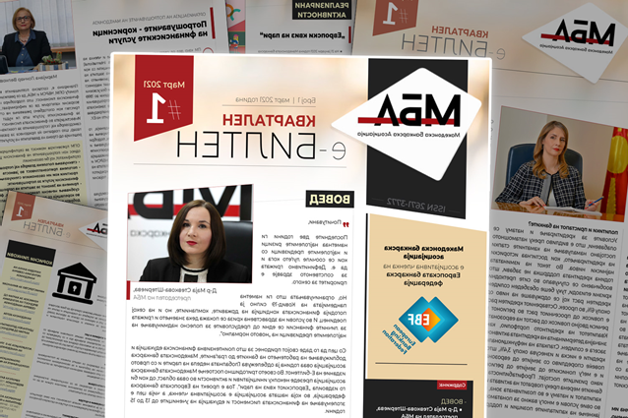
MBA’s E- Bulletin
In order to contribute to the most intensive financial education and bringing the operation of the banks closer to the citizens, the Macedonian Banking Association during this year Global/European Money week, on 26.3.2021 has issued the first edition of MBA E-bulletin, so far only in local language. The third edition of the MBA E-bulletin will be published soon.
Through this bulletin an important part of the work of the Macedonian Banking Association and its members becomes accessible to banks and saving houses employees, university and high school students of economics as well as to the overall public, in a different form, which I believe will be of great use to them.

Slide 14

Guidelines for Banks and Saving houses for transparency and standardization of information related to loans and deposits
In July, the Macedonian Banking Association and the Central Bank has brought Guidelines for Banks and Saving houses for transparency and standardization of information related to loans and deposits.
The signing of this document in the domain of the banking sector is the first and important step since the implementation of the first National Strategy for Financial Education and Financial Inclusion, which was recently adopted by the financial regulators.
.
On the left is the President of the Macedonian Banking Association and on the right is the Governor of the Central Bank

Slide 15
Thank you for your attention!

