Slide 1


Banking Transformation with SAP - Global best practices
Udo Roos, Vice President, SAP Financial Services Middle & Eastern Europe
September 5th, 2014

Slide 2
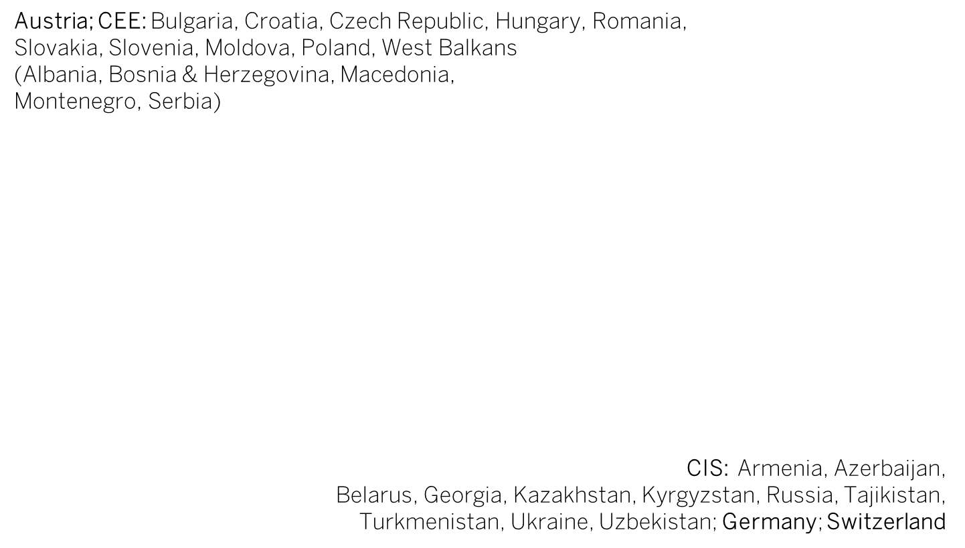
SAP Region Middle & Eastern Europe (MEE)
CIS
D
A
CEE
CH

Slide 3


























SAP Banking Global Customer Base
3,700+ Banking Customers
120 Countries
2,600+ SAP Business Analytics
1,300+ SAP Business Suite
150+ Integrated finance and risk management
180+ Core Banking
70+ Sales, Service and Marketing
1,000+ Database
200+ mCommerce
160+ Cloud

Slide 4







Industry & Market Dynamics
    IT mega-trends at work…
    Banking specific trends…
Cloud
Risk & Regulatory Compliance
Social Media
0100101011101001010100101000101010010010100010111010010101001010001010100100101000101
Big Data
Costs & Complexity
Consumerization of IT
Customer Centricity
Mobility

Slide 5


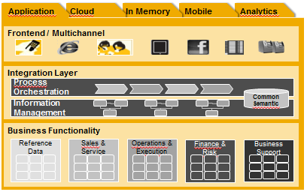
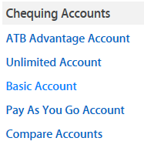

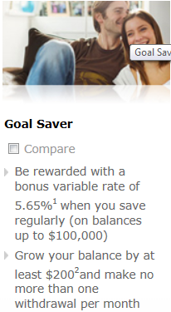




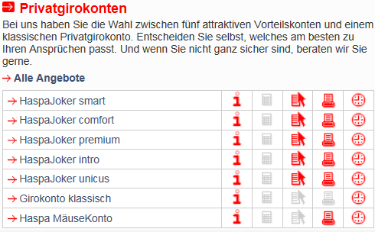

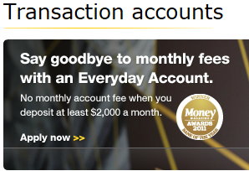



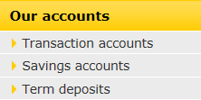

Industrialization = Standardization + Agility
Deposits
Loans
Leasing
Payments
Funding
…

Slide 6
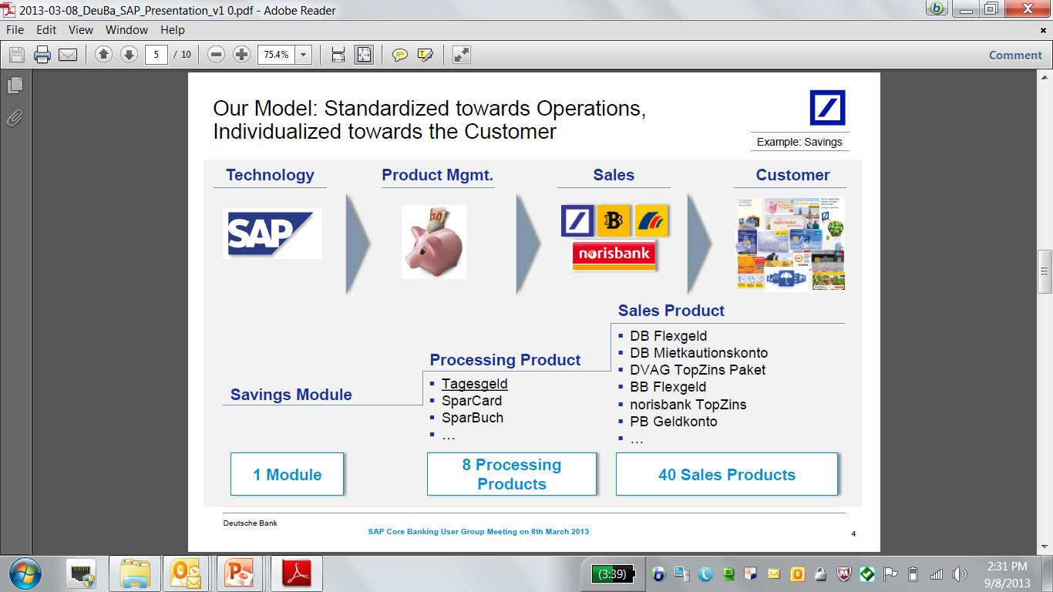
Deutsche Bank: Retail Banking Platform for multiple Brands
Standardize operations, differentiate towards the customer
25% Lower unit costs per transaction 63% Reduction in legacy product portfolio 60% Fewer interfaces to maintain 30% Faster time to market for new products 360° real-time customer view across all channels

Slide 7
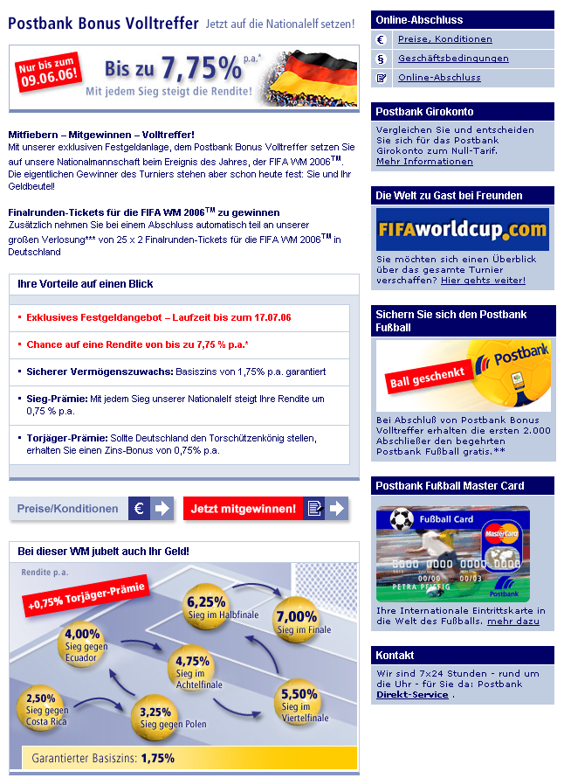
Example – Deutsche Postbank World Cup Bonus Savings
Fixed deposit account
  Interest rates
    Guaranteed interest 1,75%
    Bonus interest depending on German World cup soccer team performance
    Additional leading goal scorer bonus
    Maximum possible annual interest rate 7,75%
  Closure date on 17th of July 2006
  Starting date as soon as possible
  Amounts 2.500€, 5.000€,
  7.500€ or 10.000€
  Limitation to 10.000 accounts

Slide 8
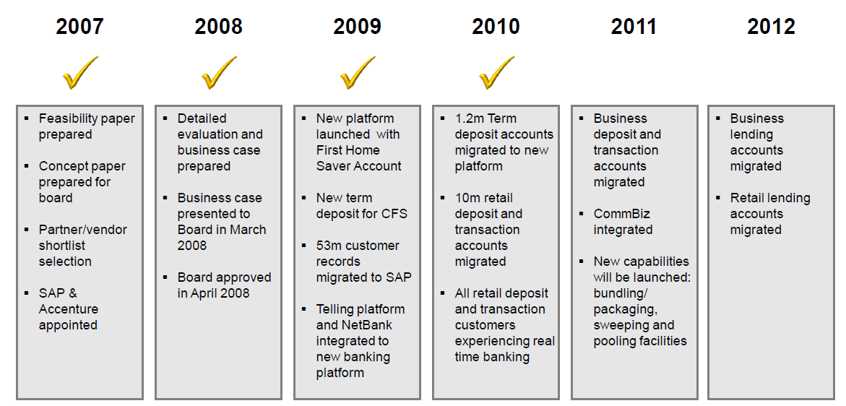

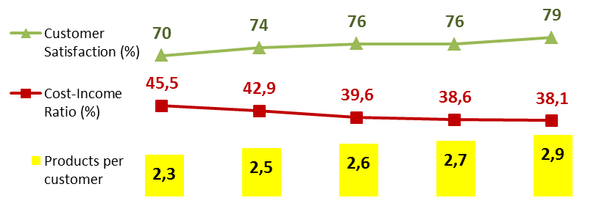
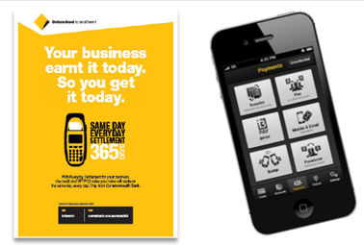
CBA gained “sustainable competitive advantage”
Roadmap
Internal Metrics
before
after
23
Data Centers
2
48
Customer Impacting Incidents/year
1
50%
IT spend on
Innovation
75%
610
Products
18
∆ Time-to-Market
-75%
External Metrics
Retail Banking Services
Source: CBA annual reports, analyst and approved project presentations; 2012 Operational Income AU$ 20B (~€14B)

Slide 9



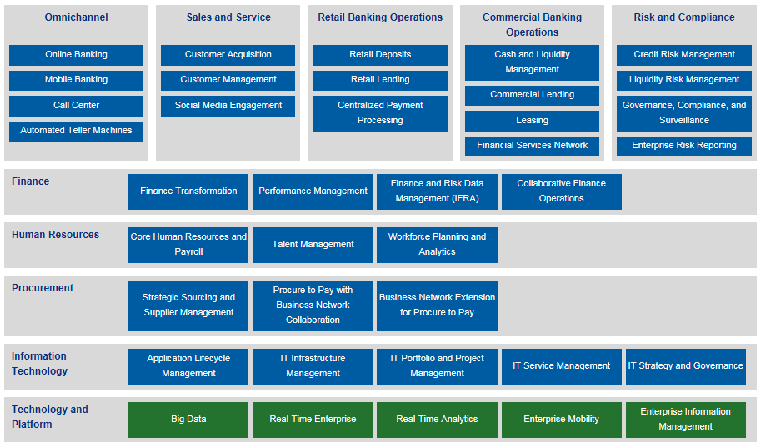




Recent Transformations with SAP Banking
Stepwise delivery of innovative solutions with predictable outcomes
Fast Time to Market
Based on SAP Core Banking, Commonwealth Bank of Australia launched most new products by configuration without programing
Real time, Anywhere
ANZ bank launched real time precise marketing via digital channels, all on SAP solutions
Loans Management
  National Bank of Canda: Cutting time to approve a customer’s loan request by -70% with SAP CRM.
Retain Customers with Predictive Technology
When customers left BOA during financial crisis in 2009, SAP InfiniteInsight enabled BOA to predict trends and quickly launch precise campaigns
Expanding by Mobile
Standard Bank collaborated with SAP to transform convenient store into mobile branches. Time needed to open a mobile
account, down 64%
High Performance Analytic
Commerzbank of Germany is producing contract-level Financial Accounting and Managerial Accounting on SAP in-memory technology
Process-oriented Banking
CMBC realized process oriented banking based on SAP technology

Slide 10
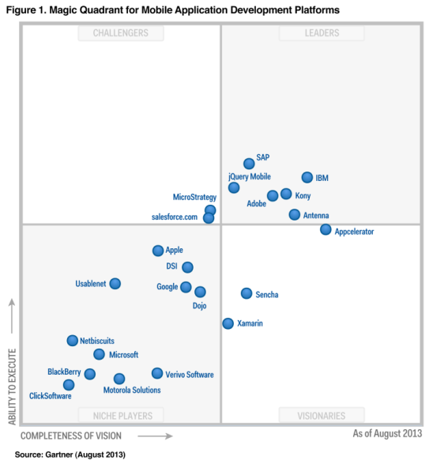
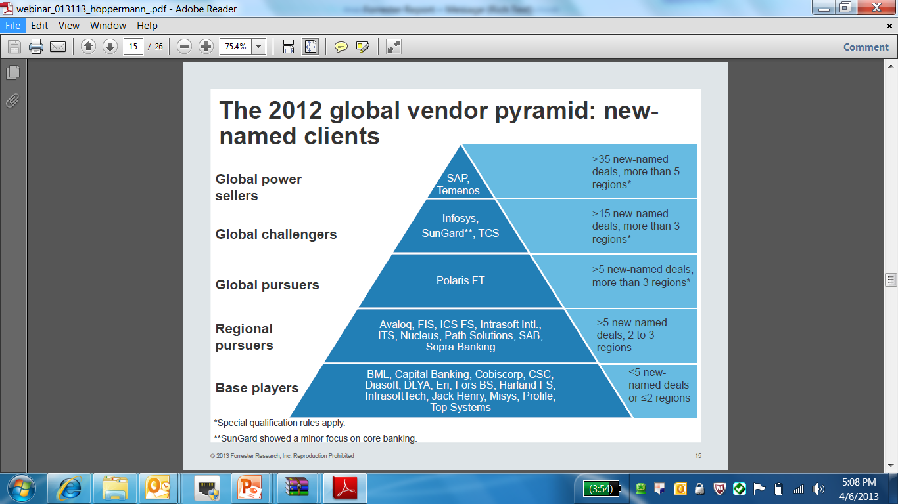
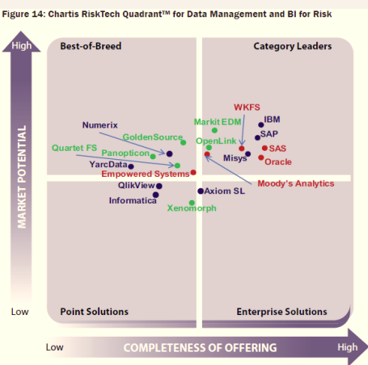
SAP is seen as a leader by key Analysts
Digital Banking Platform
Core Banking
Platform
Finance & Risk
Platform
Source: 2013 Gartner
Source: 2013 Forrester Research
Source: 2013 Chartis

Slide 11
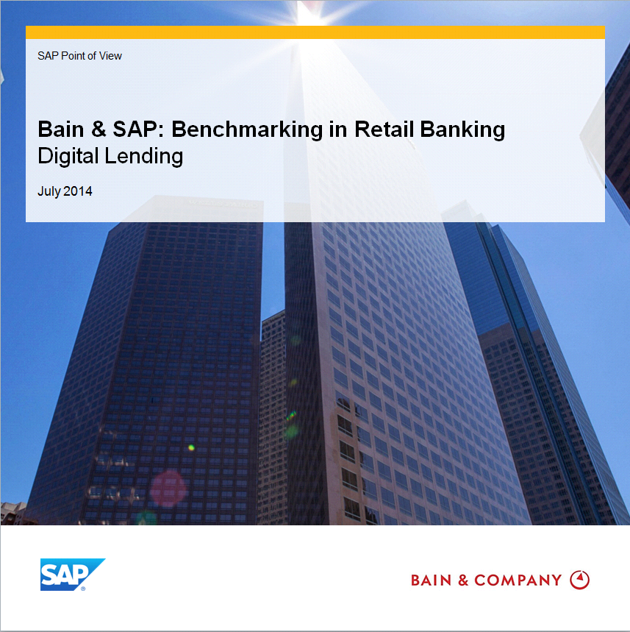
Bain & SAP: Benchmarking in Retail Banking
Digital Lending
Lending is a high value opportunity area
Lending a key driver of bank profitability
Many customers lend outside ‘main’ bank
Capital requirements driving margin optimization
Digitization enabling banks to differentiate
Improving customer experience, leading to greater share of wallet and customer loyalty
Reducing cycle times & lowering costs
Improving targeting & offers with Big Data
Best practice banks are deploying 7 core capabilities for digital lending
Our study provides insight across complex and simple loan classes
Mortgages, small business loans, personal loans, and credit cards

Slide 12
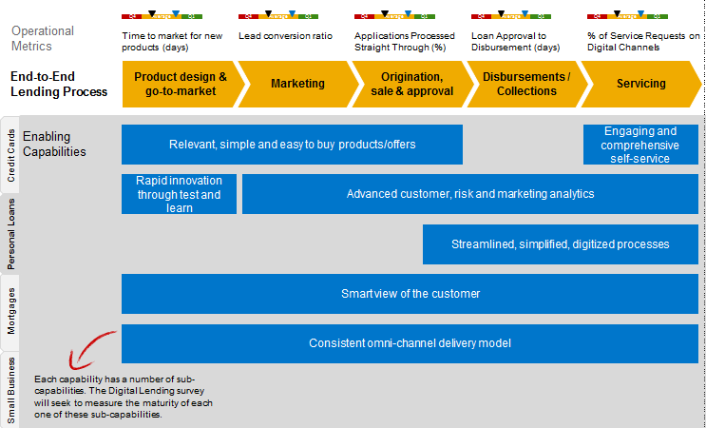
The Bain & SAP Digital Lending Benchmark Study
Enables banks understand their progress transforming lending for a digital, omnichannel world
Benchmark Schematic

Slide 13
Thank you
Contact information:
Udo Roos
Vice President
SAP Financial Services MEE
Udo.Roos@sap.com
+49 160-8896678

