Slide 1

CBDCs Across Borders Macro-Financial Implications
IMF work by MCM-SPR-LEG departments
April 2021
Presented by Annette Kyobe
Resident Representative to the Russian Federation

Slide 2
Key questions
  What is special about new forms of digital money that could lead to cross-borders use?
  How could adoption of CBDCs across borders affect monetary policy transmission, financial stability, capital flows, and the configuration of international reserves?
Introduction

Slide 3
Several Factors Determine the International Use of a Currency
Traditional
  Issuer characteristics
    Economic weight
    Geopolitics
  Economic forces
    Network effects reinforced by synergies across functions of money
    Low transaction costs
    Ease of access
    Digital features
Special to CBDC
Cross-border use of currencies falls into two categories:
  International transactions
  Currency substitution in domestic transactions
Introduction

Slide 4
CBDC Hypothetical Adoption Scenarios
Scenario 1
Niche adoption for specific international transactions
Scenario 2
Scenario 3
No adoption for local transactions
CBDC induces greater use of foreign currency in countries with lower policy credibility or underdeveloped payment systems
CBDCs are widely used as store of value, means of payment, and unit of account
Multipolarity where a few CBDCs coexist and compete
Competition can be either within or across countries
Scenarios

Slide 5
Outline
Key questions
Factors that determine the international use of currency
CBDC hypothetical adoption scenarios
Macro-financial implications
  Monetary Policy Transmission
  Financial Stability
  Capital Flows
  International Reserves

Slide 6
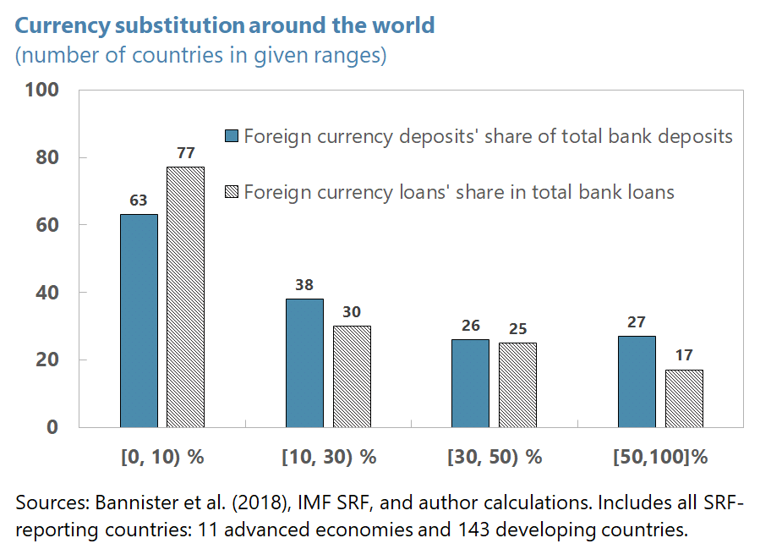
Currency substitution - a risk to monetary policy transmission
Macro-financial implications – Monetary Policy Transmission

Slide 7
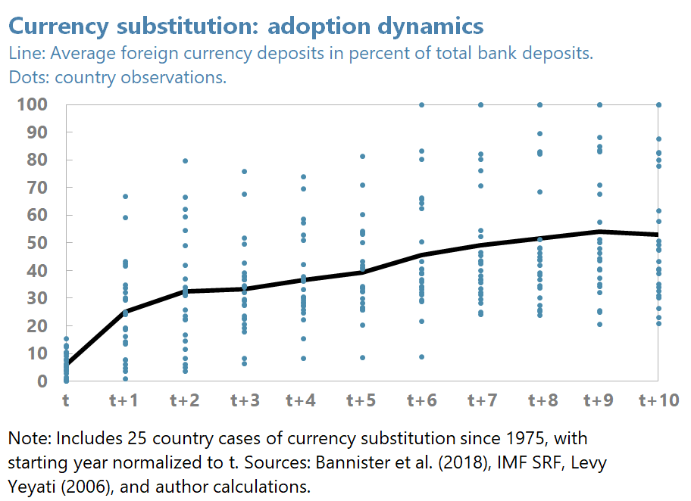
Currency substitution - a risk to monetary policy transmission
Macro-financial implications – Monetary Policy Transmission

Slide 8
CBDC may impair monetary policy transmission
If Scenario 1—the adoption of CBDC for remittances
  The impact on monetary policy may be limited
  But there’s a close link between availability of foreign currency and currency substitution
  In countries with weak fundamentals currency substitution is more likely
  If Scenario 3—each country uses multiple CBDCs
  Difficulty of exchange rate anchoring and private sector “menu costs”.
Macro-financial implications – Monetary Policy Transmission

Slide 9
CBDC may pose risks to financial stability
In addition to use in transactions, CBDC may also be attractive as a store of value posing risks
  Potentially destabilizing – funding risks, solvency risks, runs on the banking system
  Easy to move money abroad fast
  Some argue CBDCs could lead to disintermediation
  But IMF staff expect such effects can be mitigated by design choices
Macro-financial implications – Financial stability

Slide 10
CBDCs may increase capital flows and volatility
Global adoption of a single CBDC
Risks
Higher volatility, exacerbating the “policy trilemma”
Benefits
Could largely remove exchange risks and re-denomination risks;
  Global adoption of multiple CBDC
Risks
Multipolarity could also increase complexity;
Could lead to fragmentation in established market and official mechanisms to provide liquidity backstops.
Benefits
Could create more opportunities for international risk-sharing,
New classes of safe assets with superior features may merge.
Macro-financial implications – Capital Flows

Slide 11
International reserves holdings may adjust
  CBDC adoption may accelerate shifts in the configuration of international reserve currencies through powerful network effects
  Adoption of CBDCs alter the incentives for reserve holders and issuers
  For reserve holders: Greater currency substitution induced by CBDC would lead central banks to increase foreign reserves for precautionary motives.
  For reserve issuers: If internationalization is a policy objective, issuers would at least partially accommodate the shift in demand
Macro-financial implications – International Reserves

Slide 12
Implications for international reserves
Global adoption of a single CBDC
Widespread adoption of a CBDC
Would resemble to current system with the dollar as a hegemon
Stability of the system depends on the ability of the CB to ensure cyber security and provide emergency liquidity in stress times
  Global adoption with multipolarity
Multipolar world with a few widely adopted competing CBDCs
Reserve holdings could become more diversified, with stabilizing effects for the IMFS by expanding the supply of safe assets
One could envision a ‘synthetic hegemonic currency’ backed by a basket of CBDCs
Macro-financial implications – International Reserves

