Slide 1
FI Regulation in Russia:
Looking ahead at the regulatory horizon while keeping our eye on the bigger global picture

Slide 2
Agenda
1
Russian regulatory outlook generally
4
Other likely regulatory changes
2
Spotlight: new CBR draft guidelines 2016-18
5
Key factors impacting on competitiveness
3
CBR’s main priorities / fundamental policies
6
Global market trends

Slide 3
The CBR’s main goals and policies in the short- and mid-term are outlined in its recent:
Draft ‘Guidelines for the Development of the Russian Financial Market in 2016-2018’ published 19.02.16
(the ‘Draft Guidelines’).
Regulatory outlook generally

Slide 4
CBR Priorities – Overview:
In the Draft Guidelines, the CBR articulates three (3) main regulatory priorities:
Achieving prosperity of the citizenry by increasing financial inclusion
Encouraging economic growth by providing access to debt and equity finance in the corporate sector
Creating the right environment for continued financial-sector growth

Slide 5
CBR’s main policies for development of financial markets ('FMs') 1/2
The CBR intends to achieve these priorities by promoting the following ten (10) fundamental measures:
Enhancing consumer protection, boosting financial literacy of the citizenry (financial inclusion)
Promoting accessibility of financial instruments and SME lending
Discouraging bad-faith activities on the FM
Increasing consumer confidence in publicly-traded companies by developing a healthy corporate governance culture

Slide 6
CBR’s main policies for development of FM 2/2
Developing Russia’s bond / syndicated loan markets
Improving FM regulation, including a balanced (‘proportsionalnoe’) regulatory approach, optimizing the regulatory burden on financial institutions ('FIs')
Preparing appropriately qualified personnel for FIs
Developing IT tools for the FM (and FIs)
Developing cross-border communication/exchange
Improving tools for procuring FM stability

Slide 7
Interpretation of CBR 'signals' –
A selective discussion of certain of the CBR’s fundamental policies:
- financial accessibility/inclusion
- balancing the regulatory burden
- developing bonds/loans
Regulatory outlook

Slide 8
Financial accessibility / inclusion 1/4
The CBR plans to promote consumer investment in the economy, but it faces numerous challenges:
  The Russian citizenry lacks financial literacy
  The Russian citizenry tends to keep its savings ‘under the mattress’ (dead money)
  Savings are not diversified (dominance of bank deposits in the savings structure)
  Consumer protection in connection with financial services is under-developed
  Basic lack of trust in FIs

Slide 9
Financial accessibility / inclusion 2/4
What can we expect from the regulator?
  Broadening of ‘eligibility’ criteria for FIs’ officers and expanding the regulator’s rights re ‘screening’ FI officers
  Possibly an extension of the ‘regulatory consent to acquisition of a stake’ rule for participation (the 10% threshold) to FIs generally, in addition to just credit institutions (banks)
  In connection with the above, further shaping of the ‘business reputation’ concept
  Increasing liability of FIs and their officers to discourage bad-faith actions as well as liability for audit companies for poor-quality audits

Slide 10
Financial accessibility / inclusion 3/4
  Increasing liability for bad-faith actions on the FM (not just damages of the aggrieved party but some additional (unspecified) quantum – likely in the form of increased administrative liability fines)
  Procuring stability of FIs by tightening compliance requirements and increasing regulatory supervision (incl. increasing requirements for charter capital, more audits by regulator(s), etc.)
  Creating a financial ombudsmen to handle consumer claims both in banking and non-banking financial matters

Slide 11
Financial accessibility / inclusion 4/4
  Whilst not mentioned in the Draft Guidelines, CBR can be expected to overhaul (old) FSSM securities market regs
  Tightening supervision of FM SROs (e.g., NAUFOR) / raising the bar on member eligibility / imposing greater obligations on SROs to supervise their members
  Continuing implementation of corporate governance code / best practices / recommendations, whilst maintaining a ‘soft-law’ / ‘comply-or-explain’ approach
  Initiating further changes to legislation on publicly traded companies, including an increased role of the BoD and increased responsibility of BoD members

Slide 12
Balanced approach to regulation / optimizing the regulatory burden 1/4
CBR: FIs are different in types and sizes. Hence, there should be no uniform principles or rules applicable to all FIs. Ergo:
  The ‘regulatory burden’ should be proportionate to the significance of the relevant FM participant
  The ‘regulatory burden’ should also justify the final result
The CBR also aims to procure implementation of FinTech with a view to decreasing FM participants’ reporting costs
E.g., eliminating multiple requests for the same data

Slide 13
Balanced approach to regulation / optimizing the regulatory burden 2/4
Categorisation of FM participants based on their social importance or importance as market-makers (systemically important (sistemno znachimiye)) (risk-oriented regulation)
Further implementation of Basel II/III recommendations
The CBR is challenged with the task of making all Russian banks comply with Basel II/III implementation regs but at the same time easing the burden (for smaller banks) within the ambit allowed by Basel accord, espec. in difficult times (the CBR’s focus is likely to remain for now on the 10 largest, systemically-important banks)

Slide 14
Balanced approach to regulation / optimizing the regulatory burden 3/4
CBR to allow smaller FIs to outsource accounting and use modern IT technologies for compliance with reporting requirements
Major players, however, should expect more supervision / increased requirements from the CBR. This concerns banks, payment system operators, insurers, funds and other FM participants whose services are deemed socially significant and/or constituting FM ‘infrastructure’
Potentially, a requirement to obtain general liability insurance may be imposed on certain FM participants

Slide 15
Balanced approach to regulation / optimizing the regulatory burden 4/4
Given the significant growth in both supply and demand for microfinance, we expect more regulation in this area, including re. own capital and financing sources, as well as ‘screening’ of shareholders / officers of microfinance organisations (current regime: ‘a rose by any other name’ – quasi licensing)
Microfinance has a huge ‘potential’ for generating consumer complaints and deteriorating consumer confidence in the financial sector. Thus, the CBR is likely to introduce measures to reduce the incidence of consumer complaints

Slide 16
Development of the bond market, securitisation and syndicated lending 1/2
Changes to streamline the process of issuance of bonds, including reducing the amount of information to be provided and providing IT tools for exchange of documentation in bond issuances
Creating environment for emergence of globally-recognized domestic rating agencies (this will also serve to reduce the Russian FM’s dependency on rankings of foreign rating agencies)

Slide 17
Development of the bond market, securitisation and syndicated lending 2/2
Further evolution of regulations on securitisation, including changes aimed at streamlining the process, reducing procedures for securitisation of certain portfolios on an on-going basis, etc.
The current modest number of syndicated loans is mostly driven by market conditions. Thus, there are no particular actions expected in this area. Notably, Russian civil law now provides many of the instruments required for syndicated lending

Slide 18
Other areas where we can expect regulatory changes 1/2
Regulation of various new financial instruments such as crowd-financing, peer-to-peer lending, etc. may be expected in the mid-term. Unfortunately, so far it appears instruments relatively unknown to Russian regulatory authorities are banned, or their use is limited
Forex-dealers appear to be ignoring or trying to circumvent new regulation of forex-dealer activities. The CBR in turn appears to be considering forex-trading as quasi-gambling. We expect the CBR to seek to establish greater control over forex-dealer activities, incl. by stricter rules for participation in SROs.

Slide 19
Other areas where we can expect regulatory changes 2/2
Requirements relating to mitigation of IT (software) risks, incl. requirements to use domestic software for FIs deemed to be systemically significant or which provide infrastructure services
Further revisions to the recent rules on bankruptcy of individuals (once sufficient court practice reveals the loopholes for abuse of this new institute)
We expect collection agencies to be in the regulators’ sights – given recent complaints on debt collector conduct (nb February draft law)

Slide 20
The Russian FMs must compete on a global scale.
What factors in addition to CBR regulations will impact on Russia’s competitiveness?
Key systemic issues
Russian FM competitiveness

Slide 21
Commercial rule of law
Commercial rule of law is a key challenge for the Russian FM. It directly impacts on Russia’s global competitiveness. Progress depends not just on the CBR as regulator, but on other stakeholders:
  Respect by the executive branch of judicial decisions (e.g., Moscow’s ‘Night of the long bulldozers,’ Feb. 2016)
  Predictable interpretation of the laws by the courts (e.g., Tavricheski Bank case; VimpelCom case)
  Independence of the judiciary – eliminating ‘telefonnoe pravo’ (e.g., Red October case)
  Curbing predatory behavior of market / government stakeholders (e.g., Domodedovo Airport case)
  Improving the bankruptcy system (e.g., introducing pre-packs)

Slide 22
Our global banking world is changing rapidly.
How are international banks responding?
How will Russian banks stay competitive, on this shifting terrain?
Global banking trends

Slide 23
Global trends
1. Regulatory changes and complexity
2. Digitalization and technological advances
3. Changes in investment and capital sources and returns
4. Demographic and behavioural changes
5. Business operating model pressures

Slide 24
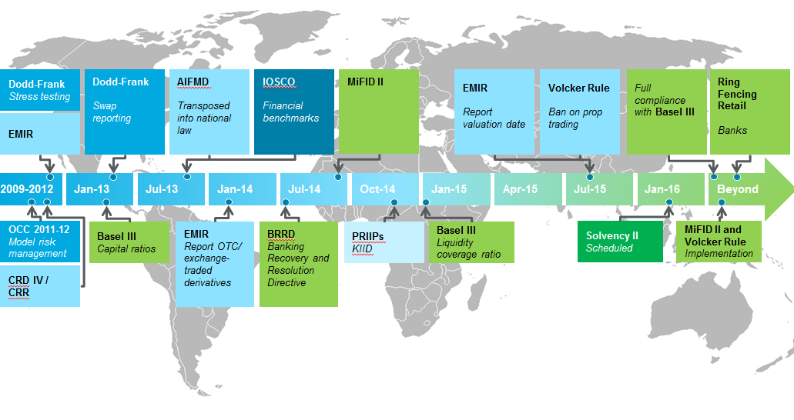
Timeline. Global regulatory framework

Slide 25
Regulatory changes and complexity
Regulatory pressures have prompted banks to divest themselves of 'risky' assets which has shaped banks’ attitude towards risk. Banks have withdrawn from lending to some constituents, such as SMEs.
Amidst this regulatory pressure, non-banking FIs, especially FinTech firms that are not subject to the same financial pressures, are offering competing services to bank clients, establishing specific funds.
Regulation reforms are likely to continue to play out over the next decade; the focus of regulation will shift more from prudential to conduct regulation

Slide 26




Digitalization and technological advancement
Market Entrants

Slide 27
Digitalization and technological advancement
New market entrants with lower start up costs who have access to a wider audience
They are able to provide lower cost services
Cybercrime, however, is a major threat
Financial Institutions are partnering with Fintech – e.g., RBS and Funding Circle

Slide 28



Changes in investment, capital sources and returns
Low Profits
Non-bank financial institutions

Slide 29
Changes in investment, capital sources and returns
Regulatory capital requirements are capping returns for existing FIs
Some non-bank FIs are more profitable
Entrants with lighter regulatory burdens are moving into areas such as lending and insurance
Result in squeeze on outside service-provider costs

Slide 30

Demographic and behavioural changes
Connect and communicate through social media platforms
Information available at fingertips
Customer expecting more value for money
Advancement in mobile application

Slide 31
Three reasons why a focus on mobile/messaging is relevant for today’s financial service industry
Messaging apps partner up to enter the finance industry
How to compete with tech-start-ups before they cannibalise the market?
Mobile is the trending access channel
How to develop a reliable mobile platform, compatible with the existing infrastructure?
Mobile offers various informational benefits
How to utilise the behavioural data generated by smartphones to engage the customer efficiently?

Slide 32
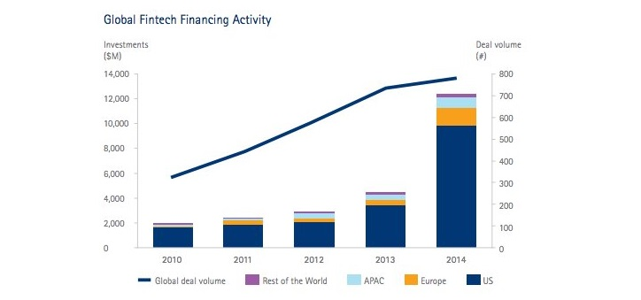
Business Operating Model Pressures
Technology is remodelling businesses by eliminating industry boundaries….
Six themes of innovation
Streamlined infrastructures
Automation of high-value activities
Reduced intermediation
The strategic role of data
Niche specialised products
Customer empowerment

Slide 33

Thank you
Tim Stubbs
  Partner,
  Head of Russian Banking & Finance Practice Group
  D +7 495 644 0500
  E timothy.stubbs@dentons.com
Tim is a partner in the Dentons Moscow and London offices. He is Head of the Dentons Russia Banking & Finance Group.
Tim has worked on Russia-related transactions for almost 25 years and has developed a reputation as a leading expert among his peers and clients. Tim specialises in cross-border transactions and financings of all types, including bilateral and syndicated lending, real estate finance, project finance and public-private partnership (PPP). Tim has a thorough understanding of the peculiarities of working with Russian and international financial institutions. This includes two years of experience at the Office of General Counsel of EBRD in London on working sabbatical (2001-2002).
Tim is a member of The American Chamber of Commerce in Russia and The Russo-British Chamber of Commerce (RBCC).

Slide 34
Thank you
Dentons Europe AO
Business center White Gardens
12th floor
Lesnaya str. 7
125047 Moscow
Russia
Dentons is the world's first polycentric global law firm. A top 20 firm on the Acritas 2015 Global Elite Brand Index, the Firm is committed to challenging the status quo in delivering consistent and uncompromising quality and value in new and inventive ways. Driven to provide clients a competitive edge, and connected to the communities where its clients want to do business, Dentons knows that understanding local cultures is crucial to successfully completing a deal, resolving a dispute or solving a business challenge. Now the world's largest law firm, Dentons' global team builds agile, tailored solutions to meet the local, national and global needs of private and public clients of any size in more than 125 locations serving 50-plus countries. www.dentons.com.
© 2015 Dentons. Dentons is a global legal practice providing client services worldwide through its member firms and affiliates. This publication is not designed to provide legal or other advice and you should not take, or refrain from taking, action based on its content. Please see dentons.com for Legal Notices.

