Slide 1
Switzerland's Financial Sector: The Role of the Swiss National Bank
Thomas Moser
Alternate Member of the Governing Board
Swiss National Bank

Slide 2
Switzerland’s Financial Sector: Some Facts
One of the world’s largest financial sector
  two of the world’s largest banks (CS, UBS)
  the world’s second largest reinsurance company (Swiss Re)
Switzerland is a global leader in private wealth management (global market share of more than 25 percent in cross-border private banking).
the Swiss financial system contributes about 10 percent to Swiss GDP and employs about 6 percent of the labor force.
Very diverse financial sector, but banking and insurance sector are highly concentrated.

Slide 3
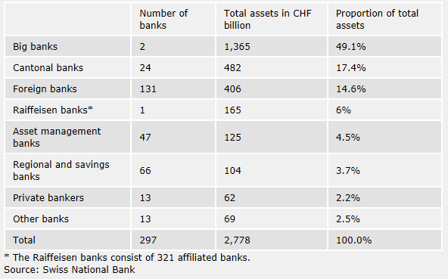

Slide 4
Constitutional and Legal Mandate of the
Swiss National Bank
Constitution, Art. 99:
As an independent central bank, the Swiss National Bank shall follow a monetary policy which serves the general interest of the country.
National Bank Act:
Art. 5:
The National Bank shall pursue a monetary policy serving the interests of the country as a whole. It shall ensure price stability. In so doing, it shall take due account of the development of the economy.
It shall contribute to the stability of the financial system.
Art. 19
In order to protect the stability of the financial system, the National Bank shall oversee systems for the clearing and settlement of payments and of transactions with financial instruments, in particular securities (payment systems; securities settlement systems).

Slide 5
Role of the Swiss National Bank (SNB) with respect to Financial Stability
Financial market supervision is the responsibility of the Swiss Financial Market Supervisory Authority (FINMA), not the Swiss National Bank (SNB).
The Swiss National Bank (SNB) is
  responsible for overseeing payment and securities settlement systems;
  the SNB monitors developments in the banking sector from the perspective of the system as a whole (Financial Stability Report);
  the SNB is responsible for the determination of systemically important banks and their systemically important functions;
  in the event of a crisis, the SNB may also act as lender of last resort;
  Macroprudential Policy: decisions on the activation, deactivation and level of the countercyclical capital buffer is made by the Federal Council, upon the proposal of the SNB.

Slide 6
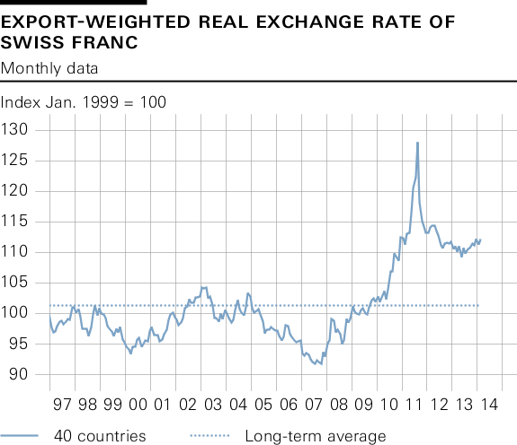

Slide 7
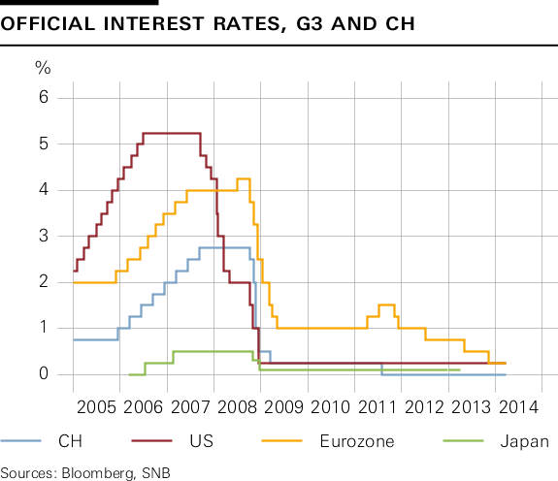

Slide 8
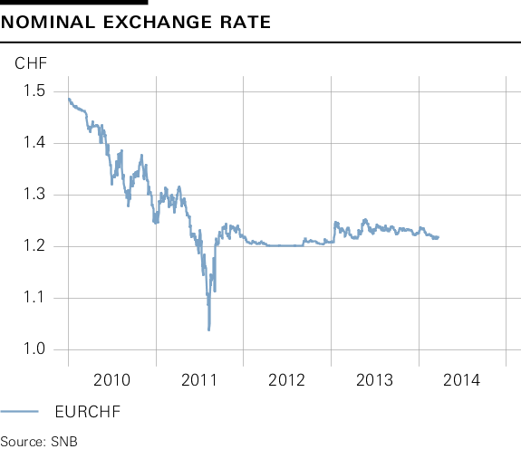

Slide 9
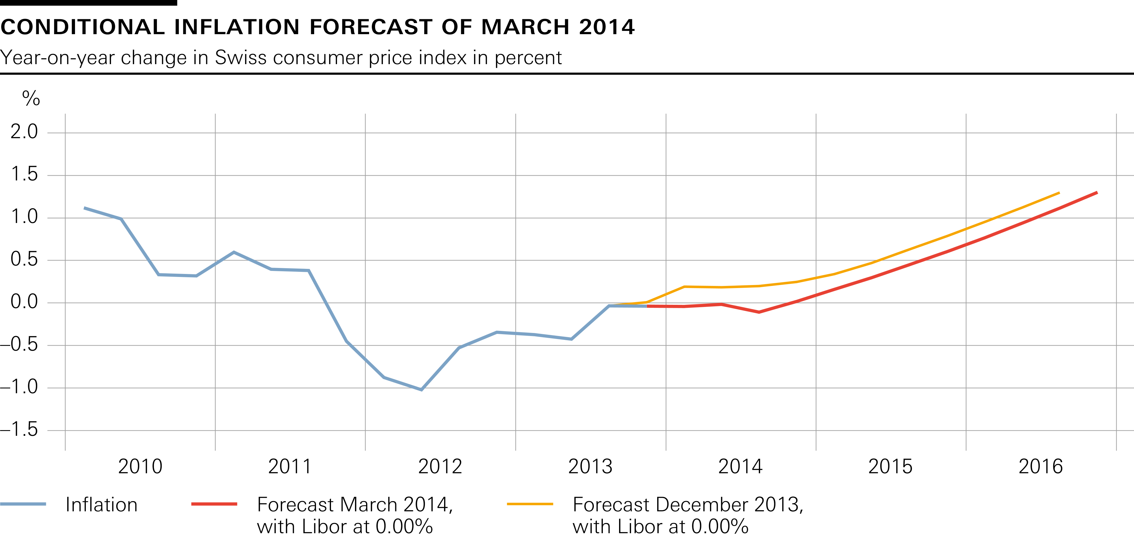

Slide 10
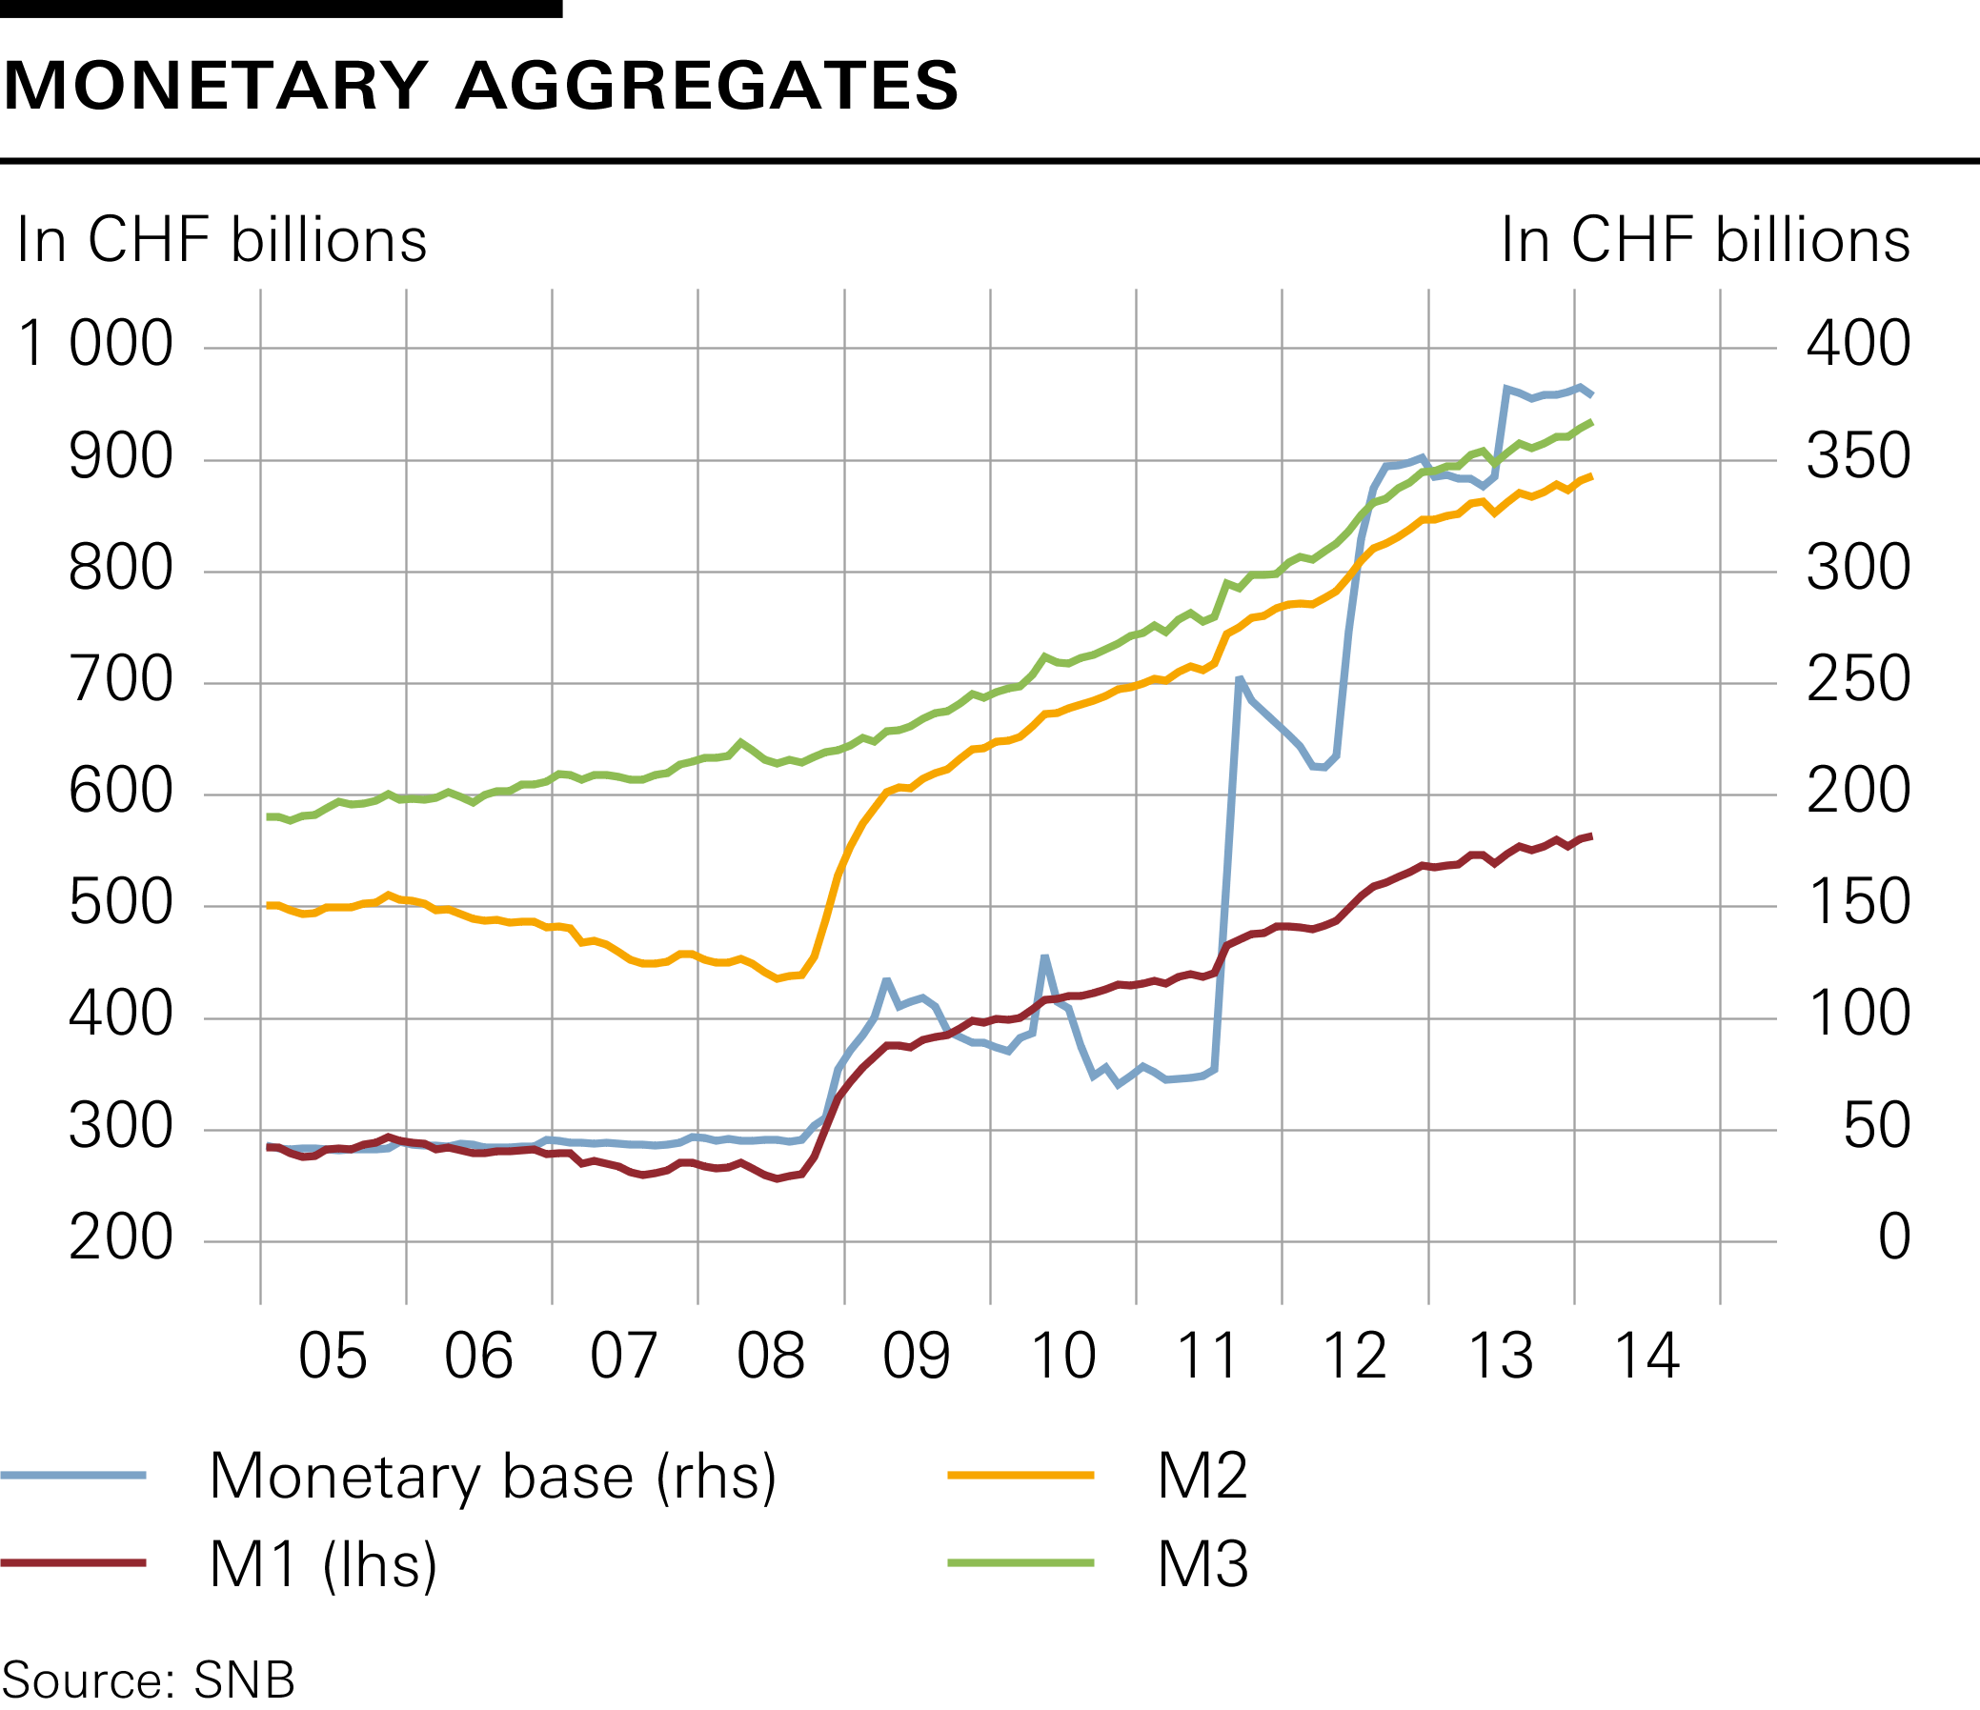

Slide 11
