Slide 1
Why Huawei
-- The world leading ICT solution provider

Slide 2







New Challenges in Banking Business
Corporate globalization
Mobile Internet
Era
Internet Banking Impact
Whole network security threats
In 10years， over 30,000 companies will cover 180+countries
By 2018，global mobile users will hit more than 8 billion
By 2017年，Mobile payments will reach 13 trillion $
Losses caused by cyber attacks over 70+ billion annually
Multinational Enterprises
transcontinental operation
Diversified financial
services demand
New Customer segmentation
New consumer habits
Mobile, Socialization
Fragmentation
Internet companies
cross-border competition
Lighter Progress
Lower Cost
Financial Cloud Services
New Risk
Management Model
Elastic adaptation, resource on demand
New interaction
Accurate positioning, process optimization
Comprehensive
risk control
Notes:
物理世界的变化

Slide 3



Success through Commit
R&D investment
Standards and patents
USD $5.4 billion in 2013
70,000 R&D employees
16 R&D centers
Membership in 170 international standards organizations such as IEEE, IETF, DMTF, Continua, and HL7
180+ positions in international standards organizations
5,000 standards-related manuscripts in 2013
Standards
Continuous increase in percentage of R&D
investment to total sales revenue
15%
44,168 patent applications in China; 14,555 PCT patent applications and 18,791 patent applications outside of China.
36,511 patent applications granted (by Dec 31, 2012).
10%
5%
9.1%
9.7%
9.7%
11.6%
13%
14%
0
Patents
2008
2009
2010
2011
2012
2013

Slide 4










Huawei R&D Centers Worldwide
Mathematical Modeling
Next Generation
Wireless
Wireless & Device
Advanced manufacturing
Sweden
Moscow
Ottawa
Wireless & Network
Paris
Beijing
Munich
Component Sourcing
Silicon Valley
Chicago
Xi An
Tokyo
Milan
Turkey
Chengdu
Nanjing
New Jersey
Shanghai
San Diego
Dallas
Wuhan
Hangzhou
Microwave
FMC, Fixed Network
Shenzhen
Headquarters
Bangalore
Next Generation Internet, Chips, and Software
San
Diego, USA
Dallas Texas, USA
Moscow, Russia
Bangalore, India
Stockholm/
Gothenburg, Sweden
Munich, Germany
Paris, France
Milan,
Italy
Notes:
招聘行业顶尖专家，通过自研与合作，进行关键技术研发，支撑产品竞争力业界领先，更好地满足客户需求，贡献行业创新；

Slide 5
Progressing as Planned By Technology Segments
Enterprise
Networking
Enterprise router:
100K Units, 109% YoY
Ranking.No. 2
LAN switch:
540K Units, 56% YoY
Ranking No.3
DC Switch:
Performance No.1
~3,000 Units shipped
Source: Gartner
Source: Dell'Oro
Source: Miercom
Wireless
LTE:
35 new eLTE contracts
53 in total
GSM-R:
13K km Coverage
WLAN:
100+% YoY
Placed in the
challengers quadrant
Source: GSA
Data Center &
Cloud
Server:
278K units, 260% YoY
No. 2 in China, No. 4 Globally
Storage:
15K Units, 18% YoY
Performance of NAS index No.1
Data center:
400+ DC
(120cloud DC)
Source : Gartner
Source: SPECsfs2008
Unified Communication &
Collaboration
VC:
31K units, 14% YoY
UC, CC:
Placed in the
challengers quadrant
VTM:
>20 Banking customers
No. 1
Large Scale Deployment

Slide 6
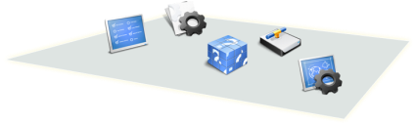

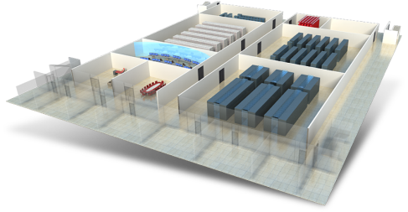


Bank Data Center
Office : e-mail, OA, video conferencing. . .
Management: financial auditing, personnel management,
Business : core business, credit approval, intermediate business
Channel : online banking, teller, ATM, POS
Management
Office
…
Channels
Business
L3: Applications
Network security core switches, firewalls
Servers, mainframes
Storage (Class A B C D)
L2: ICT Infrastructure
L1: DC Facilities
TIA 942 –iV
(International)
GB 50174 A 50462(China)
Notes:
DC have 3 levels solutions, layer1 covers the facilities and building, layer2 covers ICT infrastructure, network, storage and computing.
Layer3 covers applications.
数据中心建设分三层, L1数据中心基础建设,L2数据中心网络,计算,存储.L3,OS架构,应用开发架构,应用层面.

Slide 7


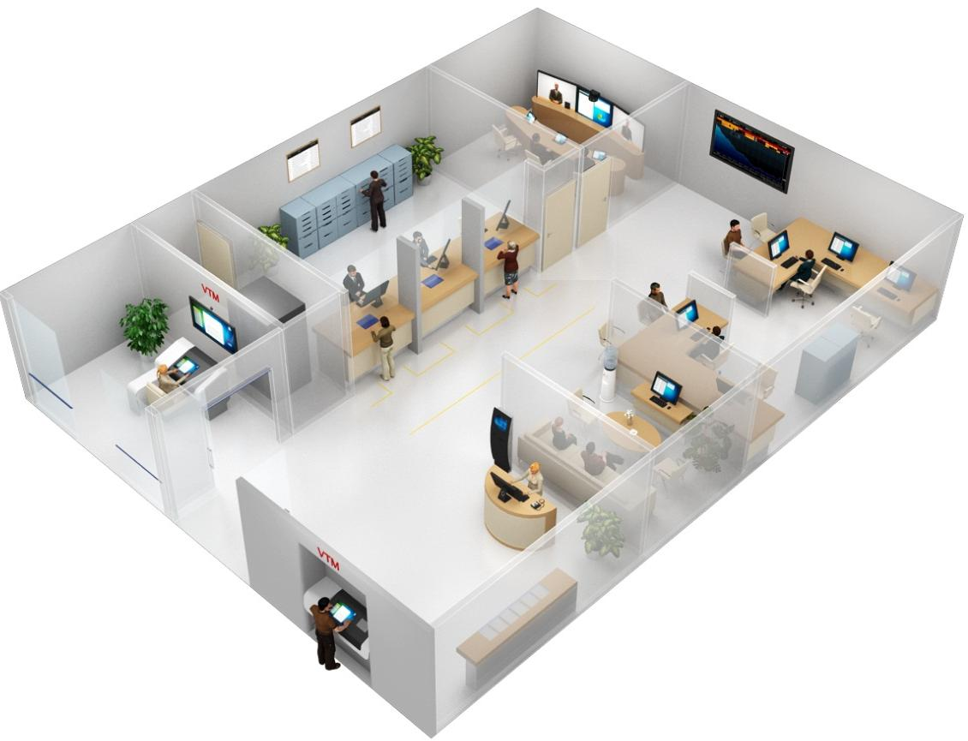

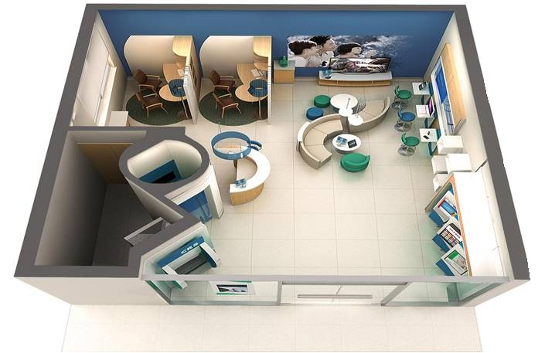




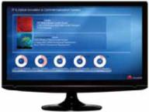

Innovation Branch Solution
Expert usage rate
Marketing success rate
Travel costs
One-stop: consisting network, voice, Wi-Fi, video surveillance, UPS, and battery
One-box
World's first 1080p at 60 fps telepresence system
Deployment efficiency
Remote wealth management consultant
IVS
All-IP intelligent video surveillance
Cloud-based VDI light counter solution
Mobile Marketing/OA
Desktop deployment efficiency
VTM
Audio and video interactive services, improving user experience
VTM
24h/7 Service Zone
Self-service
90% counter services
24 x 7

Slide 8


Cloud Platform for ICBC
DC OCC
Appl.
CORE
Intermediate
Channel access
Management Support
Dev. & test
Destop
Infra. Cloud Platform
Huawei Fusion OpenStack
Fusion
Manager
Unix Server
X86
Server
Block
Storage
Object
Storage
VPC
ELB
E.E.
APP
Deploy
Clound MNG
Infra. Service
Self. Service
Portal
Clound Orchestration
User
Mng
Virtual resouces
Fusion
Compute
Fusion
Storage
Fusion
Network
Non. Virtual Resource
VM
VM
VM
VM
Storage
Virtualization
Network
Virtualization
Perf.
Monitor
ESXi
UVP
Unify
Alert
Physical Resources
Analyst
Accounting
X86 server
X86 server
Storage
Network
Physical dev.

Slide 9









Bank mobile marketing using Huawei AnyOffice Solution
Unified portal
Secure tunnel
Mobile management platform
Interworking with Cloud
Secure SDK
Personal app & data
Enterprise app & data
Acquire
Deploy
Lifecycle
Retire
Run
Sandbox
Offers secure and unified portals for mobile applications
Sandbox for separating enterprise and personal data
SDK to rapidly secure applications
Offers Per-App tunnels
Application data encryption to prevent data interception
Dedicated tunnels to shield viruses
Offers Lifecycle Management through MDM
Rapid application integration and scalability
Open platform for enterprise mobile applications
Offers rapid integration and interworking with enterprise cloud platform
Huawei cloud platform FusionCloud Ready
HUAWEI can provide End-to-End solution

