Slide 1
v
The partner of AVTOTOR group
Bank’s Profile
www.energotransbank.com
Notes:
Титульная страница

Slide 2
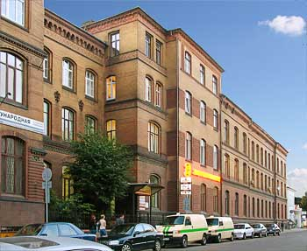
v
About Bank
The Bank was established 1990. In 2002 the Bank was reorganised from Closed Joint Stock Company to Open Joint Stock Company. The principal activities are deposit taking, loans and guarantees, payroll services, cash management, international and domestic cash transfers, securities and foreign exchange trading.
The activities of the Bank are regulated by the Central Bank of the Russian Federation (the “CBR”). The Bank has a general banking license, and is a member of the state Deposit Insurance System of the Russian Federation. The Bank has two full branches and 24 operational offices. The majority of the assets and liabilities are located in Kaliningrad, Kaliningrad region, and in the European part of Russia (West of the Eurals Mountans) including Moscow where it has its full branch.
The Bank’s registered office is in Kaliningrad (former Koenigsberg). Location has an impact on the local population and business as the nearest boarder checkpoint with Poland is 39,5 km from the city, while the closest major city in mainland Russia (Smolensk) is 900 km away across Lithuania and Belarus.
The unique feature of the Bank is the number of its registered shareholders which is about 603 000 physical persons and 110 corporate entities. This makes Energotransbank the absolute record holder in the Russian Federation in terms of shareholders diversity with Sberbank far behind with less than 50% of this figure. The sheer number of shareholders of the Bank imposes a great discipline on its management for obvious reasons. Sending 1 letter to each shareholder by post costs
These 603 000 phisical persons came into possession of the shares of the Bank in 2006 by swapping their participations in a nation-wide investment fund of the type that was popular in mid-90s into the shares of this Kaliningrad-registered Bank.
In accordance with Russian legislation the Bank publically disclosed it principal beneficial owner. Mr. Vladimir Scherbakov directly and indirectly controls about 48 percent of shares issued by the Bank.
←
2
→
Notes:
Титульная страница

Slide 3
v
About the Bank
CB “ENERGOTRANSBANK” (JSC) is one of the first commercial banks established in the territory of Kaliningrad region in the post-Soviet era. Currently it is a relatively small regional bank with solid capital adequacy and liquidity ratios well positioned in its principal area of operations. While being the largest of the locally incorporated banks, it faces competition from approximately 36 banking groups based in Moscow and St.Petersburg that have offices in Kaliningrad.
The Bank provides banking services to a large number of small and medium – sized Companies mostly (but not exclusively) located in Kaliningrad Region. It has here 24 operational offices selling banking products to members of general Public and to small local entrepreneurs. The Bank is the Principal Banker to the AVTOTOR Group of Companies who are the second – largest motor vehicle producer in Russia in terms of units sold, and the largest producer in terms of monetary value of the sales. It provides to the Group cash management, FX risk management, cross-boarder and local payment services, issues guaranties and opens or adviser letters of credit, provides payroll and other standard banking services. The Bank has no credit risk exposure to AVTOTOR Group.
Our Bank has very strong roots in Kaliningrad (former Koenigsberg). It is the Principal Banker to companies creating over 50% of Gross Regional Product and approximately 65% of commercial output of the Region.
Key figures as on 31/03/2014 (equivalent in euros):
Capital (as defined by CBR for capital adequacy purposes): 100 million
Loan portfolio: 120 million
Bonds accepted by CBR as collateral security: 40 million
Placements with institutions with investment-grate ratios from leading international rating agencies: 180 million
Operational profit 1st quarter 2014: 8 million
Total balance sheet: 340 million
Bank has 550 officers and employees
Auditor: KPMG
←
3
→
Notes:
Титульная страница

Slide 4
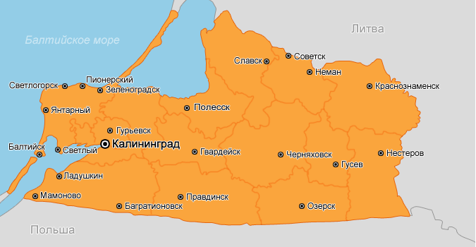
v
Kaliningrad Region
Land surface | 15 100 км2
Location | Between Lithuania (north) and Poland (south)
Population | 954, 7thousand
Population density | 62,1 pers/km2
Unemployment | 1,2%
Gross regional product (2013) | 5,5 billion euros
Average monthly income | 521 euros
←
4
→
Notes:
Титульная страница

Slide 5
v
History of Bank
IV stage
2011 – 2013
III stage
2008 - 2010
Enhancement of Bank market value due to expansion of stable client base, loan portfolio growth and increase in profit from operating performance.
Credit rating improved by “Expert RA” in December 2012 to A+ level, outlook is “stable”. This rating was confirmed on December 16, 2013. This puts the Bank into the upmost 8 pct. of ratings of all banks rated by this leading Agency.
Expansion of sales channels.
Development of product line and technologies within the scope of business lines strategic priorities: retail lending, electronic banking and development of Bank infrastructure projects.
II stage
2007
Build-up of strategic growth potential (capitalization growth), business value enhancement within the framework of full-service bank model due to the use of all sources of capitalization.
First credit rating received (В++ issued by the leading Russian rating agency “Expert RA”).
Ensuring stable position of Bank in crisis due to conservative approach to lending operations.
Gaining leadership among credit institutions of Kaliningrad region by the number of self-service devices installed in this area.
I stage
December 2006
Determination of operation concept of strategic growth potential, market strategy priorities of Bank development.
Bank developed its activity as full-service commercial bank.
Product line extension (payroll card programmes, overdraft cards, system “Gorod”).
Retail service network extension.
.
Formation of Bank strategic growth potential (increase in Bank’s own funds).
Reorganization through merger with commercial noncredit organization – “Narodny Fund”.
←
5
→
Notes:
Титульная страница

Slide 6
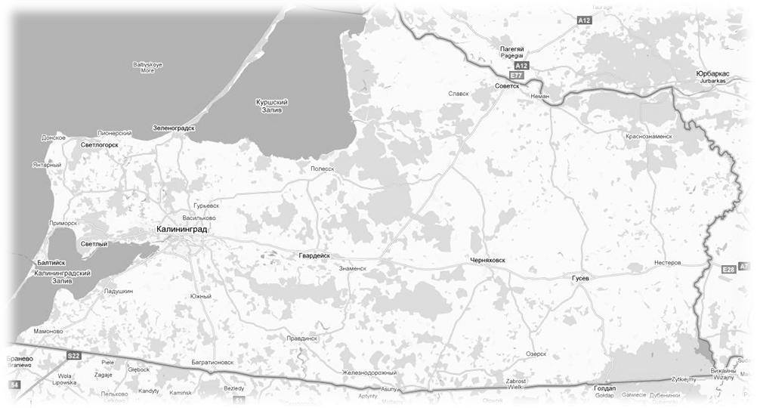
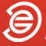

v
Geographic Footprint
Sovetsk
Neman
Zelenogradsk
Kaliningrad
Guryevsk
Chernyakhovsk
Gusev
Baltiysk
Bagrationovsk
Central operational office | Kaliningrad
Branches | Moscow, Sovetsk
Full Service Sub-branches | Kaliningrad, Baltiysk, Guryevsk, Bagrationovsk, Chernyakhovsk, Gusev, Zelenogradsk, Neman
←
6
→
Notes:
Титульная страница

Slide 7
v
Product portfolio
CB “ENERGOTRANSBANK” (JSC) is a full-service commercial bank, conducting the following business activities:
settlement and cash services to legal entities and individuals;
opening and management of accounts in local and foreign currency for residents and non-residents;
functions of currency control agent ;
trade finance transactions (letter of credit, collection);
cash collection services.
employment of funds and acceptance of deposits on various terms;
safe custody in individual safe deposit boxes;
issuance and acquiring of bank cards within payment systems of MasterCard WorldWide, Visa International and Zolotaya Korona;
credit and financial services for diverse classes of customers, including factoring ;
guarantee issuance;
securities administration (including government stocks), bill brokerage with securities of Russian issuers, purchase and negotiation of the bills of Russian enterprises and own bills of Bank;
brokerage and depositary service;
purchase, sale, conversion of cash and non-cash currency;
international money transfer and acceptance of funds without opening an account;
operations within the international money transfer systems “Western Union”, “MoneyGram”, “Contact”, “Anelik”, “BLIZKO”, “Zolotaya Korona”, “UNISTREAM”; «Leader».
remote banking service (Client-bank, Internet-bank)
consulting services
←
7
→
Notes:
Титульная страница

Slide 8
v
Corporate Management
The Bank fully implements corporate governance principles published by the Central Bank of Russia that are compliant with best international practices
Management Bodies and Committees:
The General Shareholders’ Meeting
CEO
The Management Board
Asset and Liability Committee
Credit Committee
Business Committee
Small Credit Committee
The Board of Directors
Vice Chairman of the Administrative Board , internal control
The Administrative Board
Chairman of the Administrative Board
Advisory staff
←
8
→
Notes:
Титульная страница

Slide 9
v
Bank’s Board of Directors
Full name | Position in Bank | Share in the Authorized Capital, %
Ivanov I.D. | Chairman of the Board of Directors | -
Ponomarev Y.V. | Member of the Board of Directors Chairman of the Administrative Board | -
Scherbakov V.I. | Member of the Board of Directors | 0,00014 %
Scherbakov S.V. | Member of the Board of Directors | -
Vildanova M.M. | Member of the Board of Directors | -
Zhukov M.V. | Member of the Board of Directors | -
Malygina O.S. | Member of the Board of Directors | -
Pogodina O.V. | Member of the Board of Directors | -
Preksin O.M. | Member of the Board of Directors | -
←
9
→
Notes:
Титульная страница

Slide 10

v
Deposit Insurance
In compliance with the provisions of Federal Law No. 177-FZ as of December 23, 2003 “On insurance of deposits of physical persons held with banks of the Russian Federation” CB “ENERGOTRANSBANK” (JSC) is a participant of compulsory deposit insurance system (Certificate on Bank’s incorporation into the register of banks participating in the deposit insurance system No. 625 as of 10.02.2005).
According to the aforementioned law, insurance indemnity, regarding the deposit , in respect of which the insured event has occurred, shall be paid to the depositor in the volume of 100% of the total amounts of deposits held with the bank, but not more than 700 000 RUR (for insured events).
Maximum indemnity amount shall be 700 000 for all the deposits and accounts, held with one bank. Deposits held with various banks shall be insured independently.
←
10
→
Notes:
Титульная страница

Slide 11
v
Regional Programs Participation
In the year 2013 Bank has supported the following regional programs:
Partner of State Autonomous Agency (GAU) for Kaliningrad region “Fund for Business Support” with regard to implementation of the Programme of support of small and medium-sized enterprises in Kaliningrad region (Agreement dated May 15, 2010).
Subject to Order No. 2117 of 19.10.2012 issued by Federal Customs service of the Russian Federation CB “ENERGOTRANSBANK” (JSC) is included into the Register of banks, other credit establishments and the insurance companies, which provide bank guarantees acceptable by customs authorities as a security of customs charges and tax payment. Maximum amount of all concurrent bank guarantees for the Bank is 700 mln. RUR.
←
11
→
Notes:
Титульная страница

Slide 12

v
Environmental Protection
With the view of compliance with Federal Law No.7-ФЗ as of 10.01.2002 “On Environmental Protection”, Bank has been paying contributions to local division of Rosprirodnadzor (Federal Service for Supervision of Natural Resources Usage).
For the year 2013 Bank transferred more than 150 000 RUR.
←
12
→
Notes:
Титульная страница

Slide 13
v
AVTOTOR in cooperation with a number of leading western companies has started works on setting-up of a full-cycle automobile manufacturing cluster in the Kaliningrad region. Once completed, the project is expected to combine new vehicle production factories and several new joint ventures for automotive components production. It is anticipated that up to six full-cycle vehicle assembly operations for different automakers and up to 15 automotive components production plants will be set up in Kaliningrad. The automotive components facilities will produce parts for Avtotor's needs, and may also supply to other Russian automotive companies as well as export parts to other countries.
Agreements to that effect has been signed with Magna International who are a leading global automotive supplier and who already have manufacturing operations in 27 countries. Original equipment manufacturers concerned will include a number of leading global brands who have signed documents ranging from Letters of Intent to definitive investment agreements. Total investments commitments currently stand at 1,5 billion euros and may substantially increase as the project takes shape. AVTOTOR already produces more than 30 models for such brands as BMW, Cadillac, KIA, Opel, Chevrolet and Hyundai.
The project is coordinated with Russian state investment programs who have committed to invest in road construction and other elements of the surrounding environment.
When completed the project will generate annual sales of approximately 6 billion euros. This investment will have a profound effect on the business climate and living conditions in Kaliningrad area.
CB “Energotransbank” is involved in certain aspects of the Project such as setting up financing and mortgage programs for construction of about 50 thousand compartments in the vicinity of the site, cash management and risk management procedures for parts of the Project financed by AVTOTOR.
←
13
→
Notes:
Титульная страница

Slide 14
v
CB “ENERGOTRANSBANK (JSC)
Registration Number: 1307
General Banking License issued by Central Bank of Russian Federation
No.1307 as of December 13, 2005
83-A Klinicheskaya street, Kaliningrad, 236016
Telephone: +7 (4012) 59-00-99
e-mail: mail@energotransbank.com
http://www.energotransbank.com
SOVIETSKIY BRANCH OF COMMERCIAL BANK “ENERGOTRANSBANK” open joint stock company SOVIETSKIY FKB “ENERGOTRANSBANK” (JSC) Registration number in the Bank of Russia Branch Register : 1307/1, location: 9 Goncharova street, Sovetsk, Kaliningrad region, 238750 | MOSCOW BRANCH OF COMMERCIAL BAKN “ENERGOTRANSBANK” open joint stock company MOSCOW FKB “ENERGOTRANSBANK” (JSC) Registration number in the Bank of Russia Branch Register : 1307/4, location: bldg.3, 3 Solyanka street, Moscow, 109028.
←
14
→
Notes:
Титульная страница

Slide 15
19 March 2014
Thank you for your attention!
www.energotransbank.com
Notes:
Титульная страница

