Slide 1
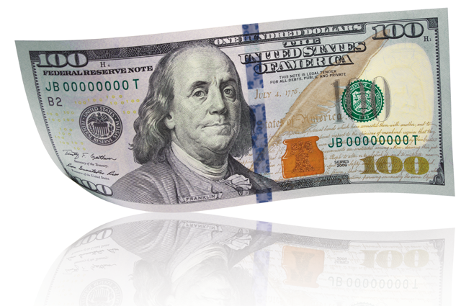
US $100 Banknote Creasing:
History and Resolution
Federal Reserve Efficiency Efforts, Uncertainty, and
Issuing the New-Design $100 Federal Reserve Note
Michael Lambert
Associate Director
The Board of Governors of the Federal Reserve System

Slide 2
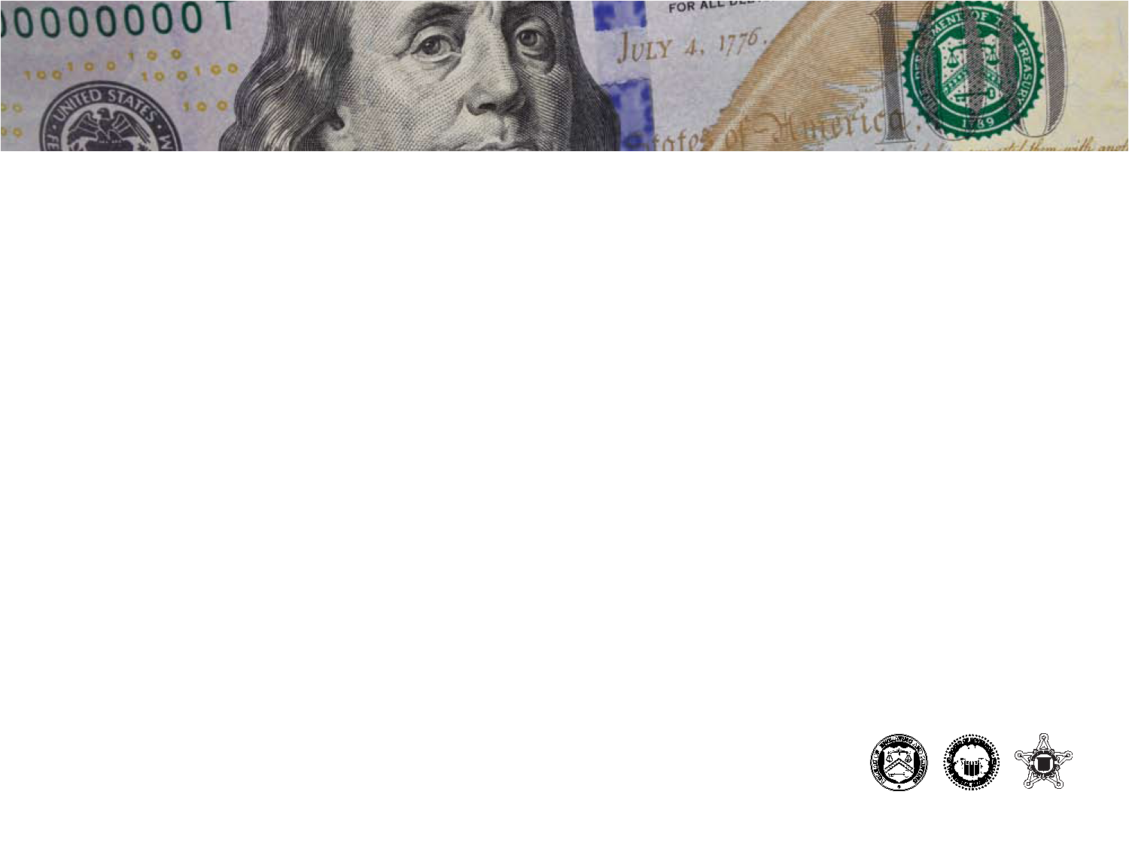
Agenda
The Federal Reserve’s role in the cash cycle
Efforts to improve efficiency
Demand conditions and planning for uncertainty
Preparing to issue the new-design $100
New $100 Note Issued
2

Slide 3
The Federal Reserve’s Role in the
Cash Cycle
Board as Issuing Authority; Reserve Banks distribution and processing roles
Ensure notes are authentic and “fit for commerce”
Encourages recirculation of fit notes by commercial banks
Provides a machine calibration testing program and publishes fitness guidelines
3

Slide 4
Growth Remains Strong

Slide 5
Processing Needs to be Flexible

Slide 6
Effects of Recirculation Policy
Decreased number of times $10 and $20 notes return to the Reserve Banks
Inventory Turn Rate
Times processed per year
 | 1s | 2s | 5s | 10s | 20s | 50s | 100s | Total
2000 | 1.3 | 0.0 | 1.3 | 1.6 | 2.8 | 1.1 | 0.4 | 1.5
2001 | 1.6 | 0.0 | 1.3 | 1.5 | 2.8 | 1.0 | 0.4 | 1.5
2002 | 1.5 | 0.0 | 1.3 | 1.5 | 2.9 | 1.0 | 0.4 | 1.5
2003 | 1.5 | 0.0 | 1.3 | 1.4 | 2.8 | 1.0 | 0.4 | 1.5
2004 | 1.5 | 0.0 | 1.3 | 1.5 | 2.9 | 1.1 | 0.4 | 1.5
2005 | 1.5 | 0.0 | 1.3 | 1.4 | 2.7 | 1.0 | 0.4 | 1.4
2006 | 1.5 | 0.0 | 1.3 | 1.4 | 2.6 | 1.0 | 0.4 | 1.4
2007 | 1.4 | 0.0 | 1.3 | 1.2 | 2.3 | 1.0 | 0.4 | 1.3
2008 | 1.4 | 0.0 | 1.3 | 1.1 | 2.0 | 1.0 | 0.4 | 1.2
2009 | 1.3 | 0.0 | 1.2 | 1.1 | 1.8 | 0.8 | 0.3 | 1.1
2010 | 1.3 | 0.0 | 1.2 | 1.0 | 1.8 | 0.8 | 0.3 | 1.1
2011 | 1.2 | 0.0 | 1.2 | 1.0 | 1.7 | 0.8 | 0.3 | 1.0
2012 | 1.1 | 0.0 | 1.2 | 0.9 | 1.6 | 0.8 | 0.3 | 1.0

Slide 7
Upgraded High Speed Processing Machines and Sensors
Upgraded machines increased efficiency almost 50 percent
  BPH from low 70s to high 90s (from less than 20 notes per second to about 30 notes per second).
  Staff (as measured by ANP) decreased from 1500 to 1350
Increased fitness sorting and authentication capabilities reduced shred rates and increased note life.
  Shred rates for $1 notes decreased from 50 to 15 percent
  Note life increased from 1.4 to 5.9 years

Slide 8
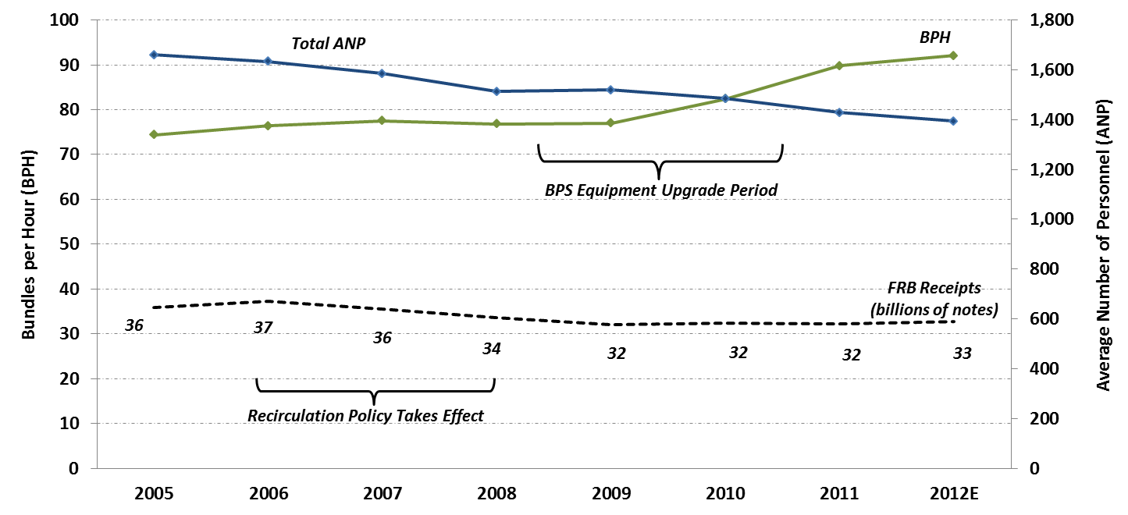
Recirculation and Upgrade Efficiencies

Slide 9
Sensor Upgrades and Policy Change Effects on $1 Notes

Slide 10
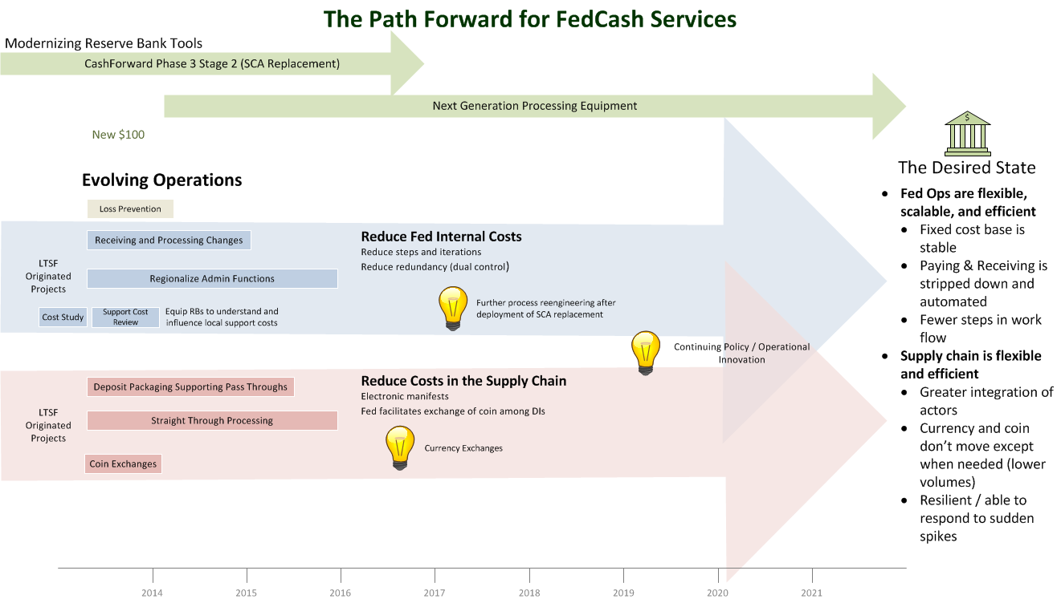
The Path Forward

Slide 11
$100 Note Demand is Strong
We needed to plan for strong demand when preparing to issue the new-design note
  About 9 billion $100 notes in circulation
  Planned to replace half in first year after issue
Needed to build inventories of new-design while maintaining inventories of old-design
  Significant strain on vault capacity
  Careful management of shred policy of old-design notes
11

Slide 12
$100 Notes in Circulation
(billions of notes)
*2013 data are through June

Slide 13
$100 Note Inventory and Payments
(12-month rolling average, millions of pieces)

Slide 14
$100 Note Inventory By Design Type
(millions of pieces)

Slide 15
Low Risk of Insufficient Inventory
Sensitivity analysis is based on average monthly $100 note payments to circulation during 2012

Slide 16

Release Date: April 24, 2013
For immediate release
The Federal Reserve Board on Wednesday announced that the redesigned $100 note will begin circulating on October 8, 2013. This note, which incorporates new security features such as a blue, 3-D security ribbon, will be easier for the public to authenticate but more difficult for counterfeiters to replicate.
The new design for the $100 note was unveiled in 2010, but its introduction was postponed following an unexpected production delay. To ensure a smooth transition to the redesigned note when it begins circulating in October, the U.S. Currency Education Program is reaching out to businesses and consumers around the world to raise awareness about the new design and inform them about how to use its security features. More information about the new design $100 note, as well as training and educational materials, can be found at www.newmoney.gov.
16

Slide 17
Goal: To protect and maintain confidence in Federal Reserve notes
Global Currency Education
Overall Program Objectives:
Educate users of U.S. currency about:
The appearance of genuine Federal Reserve notes
The security features in genuine banknotes
How to use security features to differentiate between genuine and counterfeit banknotes

Slide 18
Highlights of the $100 Note Program
More than 30 international and domestic training seminars in locales ranging from Angola to Vietnam;
25 international and domestic media events on or around the October 8 issue date hosted by U.S. embassies internationally and Federal Reserve Banks domestically; and
An email outreach program to more than 170,000 U.S. cash handlers and law enforcement stakeholders with information about how to prepare for the introduction of the redesigned $100 note.
10 different educational materials in 25 languages.

Slide 19
How We Educate
Global Audience
Events
Website
Training
Media Outreach
Integration
Fulfillment
Conferences
Direct Outreach
Social Media

Slide 20
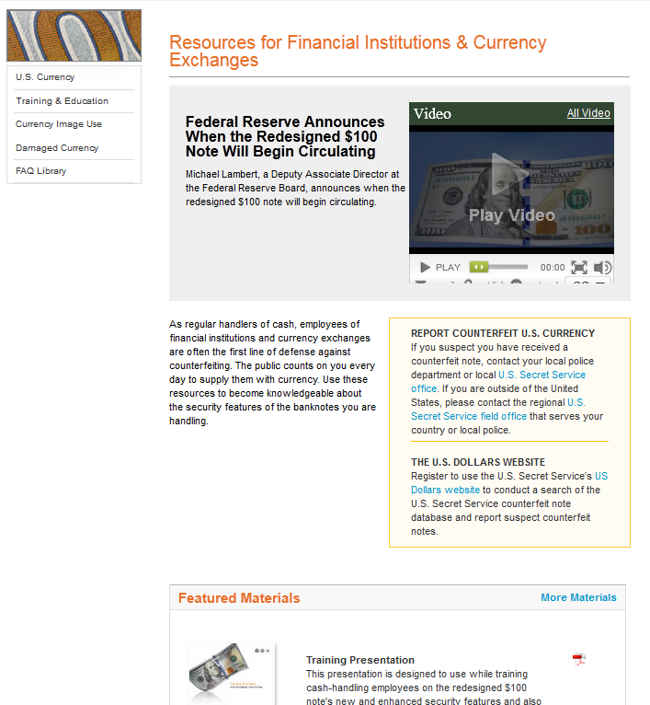
Resources for Financial Institutions

Slide 21
Now Circulating!
www.newmoney.gov
Notes:
Thank you.

