Slide 1
International online conference «Digital currency of the Central Bank – innovation while maintaining trust» 20th April 2021
Introductory remarks
Alexander Khandruev
Vice-president, Association of Banks of Russia

Slide 2
Panel session 1
Most central banks are now exploring central bank digital currencies (CBDCs) and moving from research to experiments and pilot projects. Motives for CBDC issuance vary across countries. Pros and cons for issuing a CBDC and its design choices are driven by domestic circumstances. Nevertheless, there are common underlying principles for all central banks that intend to issue a CBDC
Speaking at the Peterson Institute for International Economics on March 31, 2021, Agustin Carstens, the BIS General Manager emphasized: “A recent report by the Group of Central Banks lays out foundational principles for CBDCs, including the monetary Hippocratic Oath (“do no harm”). Just as doctors have a duty to their patients, so do central banks to society”
“Do no harm”. New forms of money supplied by the central bank should continue supporting the fulfilment of public policy objectives and should not interfere with or impede a central bank’s ability to carry out its mandate for monetary and financial stability” /р. 10/
/Group of central banks* (2020): “Central bank digital currencies: foundational principles and core features”, Joint Report, no 1, October, BIS.
*Bank of Canada, European Central Bank, Bank of Japan, Sveriges Riksbank, Swiss National Bank, Bank of England, Board of Governors Federal Reserve System, Bank for International Settlements/

Slide 3
Three potential key threats that may bring unforeseen and irreversible consequences
1. The definition of CBDC is still unclear, legal framework is uncertain
Correct definition: CBDCs are a technologically advanced representation of central bank money
Unclear definition: CBDC would become a new form of money that exists alongside cash and bank deposits, rather than replaces them
In this case, it might erase the fundamental differences between base money and broad money
The use of a blurred definition may have negative consequences: CBDC will gradually crowd out other forms of money and turn into a monopoly form of money

Slide 4
Three potential key threats that may bring unforeseen and irreversible consequences
2. Use of a blurred CBDC definition can have a negative impact on financial stability and the development of banking systems
CBDC will compete with the money of the banking sector. As a risk-free asset, it may start to replace them not only in times of crisis
In order to maintain financial stability, a course will be taken to move from a fractional reserve system to “narrow” (full-reserve) banking, i.e. a total separation of bank deposit accounts from all other bank activities
If central banks will partially (or fully) provide loans to businesses and households, then the two-tier banking system transforms into a single-tier one. Banks will become payment agents

Slide 5
Three potential key threats that may bring unforeseen and irreversible consequences
3. Use of a blurred CBDC definition can have a negative impact on monetary policy
Gradual replacement of other forms of money can serve as an incentive to revise the approaches to the conduct of monetary policy
Targeted nature of the CBDC issuance will open the gateway to a “programmable” monetary policy, where money transmission mechanism would be simplified and accelerated. This could be become a helicopter monetary policy
The monetary policy operating procedure will be based on direct quantitative restrictions and use, among other things, such tools as “marking”, demurrage and other limitations

Slide 6
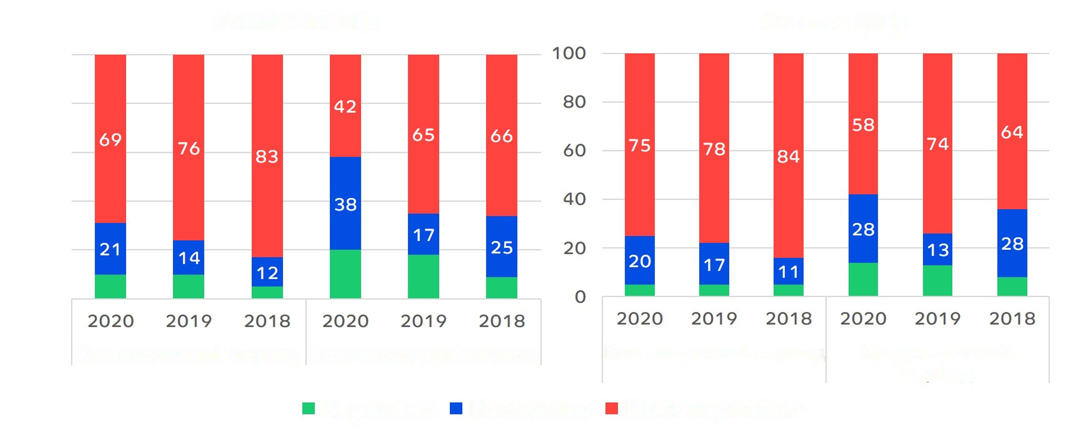
What are the chances that the countries will continue to work on the issuance?
(share of respondents)
in the short term and in the medium term
Retail CBDC
Wholesale CBDC
Short-term period
Medium-term period
Short-term period
Medium-term period
Probable
Possible
Unlikely
Source: Boar C., Wehrli A. (2021) Ready, steady, go? – Results of the third BIS survey on central bank digital currency // BIS Papers № 114

Slide 7
Questions
How will CBDC affect the demand for money, bank deposits, the supply of credit, and the structure of financial markets?
What are the perspectives for maintaining the traditional role of banking systems?
Why can’t the stated goals be achieved through the means available?
What new things will the CBDC give to the public?

