Slide 1

THE CASH CYCLE IN ITALY
AND
THE MONITORING ACTIVITY BY BANCA D’ITALIA ON CASH HANDLERS
Mr. Luigi Concistre’ Banca d’Italia / Embassy of Italy

Slide 2
Outline
The cash cycle in Italy – general overview and the actors involved
The role of Banca d’Italia in the monitoring of cash cycle
Banca d’Italia control activity: legal framework
Types of controls on cash handlers
On-site inspections
Off-site monitoring
Corrective measures and sanctions

Slide 3



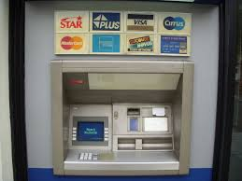
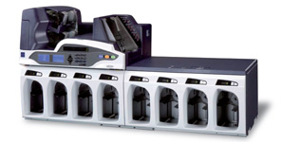

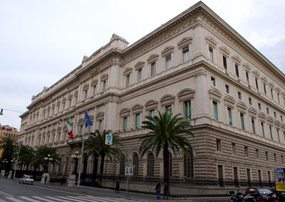
The cash cycle in Italy
general overview and the actors involved
58 CIT companies
FRAGMENTED SECTOR
136 Cash Centres
Central role of the CITs in the cash cycle
181 billion of €
Only 20% of BNs are recirculated by Banca d’Italia
3.6 billion
of BNs recirculated
Many CIT companies are very small
48,730 ATMs
1.2 billion of
BN recirculated
1.3 billion of
BN recirculated
34,519
branches
BIG EFFORT FOR
MODERNISATION
IS NEEDED
32 branches
600 Credit Institutions
3
Notes:
Il circuito del contante in Italia è caratterizzato da un ruolo preponderante delle società di servizio (Cash In Transit – CIT)
Solo il 20% delle banconote trattate sul territorio nazionale vengono ricircolate dalla Banca d’Italia
Il mercato delle società di servizi risulta essere molto frammentato con molte società di servizi che spesso presentano una dimensione molto contenuta.
Ciò comporta, al fine di garantire la qualità delle banconote in circolazione e un’efficace lotta alla contraffazione, la necessità da una parte di porre in essere un sistema di regole sull’attività di ricircolo del contante svolta da questi operatori e dall’altra di favorire le condizioni per uno sviluppo virtuoso del settore. Il quadro normativo sul ricircolo del contante va in questo verso.

Slide 4
BANCA D’ITALIA MONITORING OF THE CASH CYCLE
to keep under control:
Object -> banknotes handling: machines and procedures
Subject -> professional cash handlers: organizational “quality”
Flows -> trends and “anomaly” indicators
High level security in banknotes handling
Cash cycle reliability

Slide 5
Banca d’Italia control activity. Legal framework
EUROPEAN
Council Regulation EC no. 1338/2001 as modified by Council Regulation EC n. 44/2009
laying down measures necessary for the protection of the euro against counterfeiting
ECB DECISION 2010/14 as modified by ECB DECISION 2012/19
on the authenticity and fitness checking and recirculation of euro banknotes
NATIONAL
Art. 97 of the decree-law no. 1/2012, converted into law 24 March 2012, no. 27
implementing the EU legislation on counterfeiting and the ECB decision on the recirculation of banknotes
Banca d’Italia Regulation of 14 February 2012
laying down provisions on cash handling activities
in force since 1 January 2011 replacing the “Banknote Recycling Framework” (BRF published in 2004)

Slide 6
Banca d’Italia control activity. Legal framework
Rationale and objectives
to protect the public from receiving counterfeits
to provide common rules/procedures to professional cash handlers to retain counterfeits and re-issue only genuine and fit euro banknotes

Slide 7
Types of controls on cash handlers
On-site
  Unannounced on-site inspections to check
    machines (authenticity and fitness detection, traceability of transactions)
    organisational structure and procedures governing the cash handling activity
Off-site
  to monitor the cash handlers’ activity regularly and supervise the cash cycle trends

Slide 8
On-site inspections
Risk control
Inventory checks
Organisational structure
Adequacy
Operational processes
Mapping
Banknote handling machines
Compliance
Internal control system
Adequacy
Training / Role awareness / Control culture
Human resources
Administrative / accounting system
Reliability
Statistical data and information reported to Banca d’Italia
Reliability
Compliance
Outsourcing

Slide 9
Off-site monitoring
STORING AND MONITORING THE DATA ON CASH RECYCLING
To conduct monitoring of professional cash handlers activity the data provided biannually need to be stored and updated together with any other relevant information on supervised subjects
A RECORD FOR EACH PROFESSIONAL CASH HANDLER
Analysis of cash activity development
Monitoring the correctness of statistical data provided
Analysis of specifically created early warning indicator (for each cash handler, on biannual data)
OPERATIONAL DATA ARCHIVES
% change of cash recycling volumes for each sorting machine
% of remote branches’ activity on total volumes processed
% change of cash recycling volumes
% of unfit banknotes on total processed

Slide 10
Corrective measures and sanctions
Corrective measures
  tailored in accordance with the type - seriousness of anomalies
  deadline for the requested actions
Sanctions
  prohibition from recirculating banknotes
  (at least from operating the non-compliant machine)
  removal from the list on the ECB website due to non-compliance of the banknote handling machine
  pecuniary administrative sanctions from € 5,000 to € 50,000

Slide 11
Bankitalia.mosca@esteri.it
Спасибо

